Slide 1
10/10/2022
ADRESSING THE PRACTICAL PROBLEMS WITH ESG IN WEALTH MANAGEMENT
KENDRICK WAKEMAN, CFA
Advisor, First Rate Ventures
Partner, qSpur Consulting

Slide 2
WHAT ESG IS NOT
NOT new
First fund established by Pioneer Investments in 1928
NOT a fad
Retail Wealth ESG assets under management up 92% 2015-2019 ¹ (S&P 500 up 40%)
NOT ESG
Much broader than that. Includes faith-based investing, political/geopolitical investing, and many other values-based criteria.
Notes:
There are 64 common categories but over 700 different indicators across all vendors
MSCI uses a special indicator that describes how important that attribute is to an industry or specific company. Scope is therefore the largest contributor for that vendor only.

Slide 3
ESG IS NOT FOR WEALTH MANAGEMENT
Legacy providers largely service Asset Managers
ESG ratings firms make most of their money selling ESG ratings to ESG managers to create ESG Funds and ETFs
Legacy providers unlikely to change focus soon
Would need to dramatically cut price.
Would need to beef up a separate sales force.
Wealth Managers have different ESG needs
Standardization
Clarity
Customization
Notes:
There are 64 common categories but over 700 different indicators across all vendors
MSCI uses a special indicator that describes how important that attribute is to an industry or specific company. Scope is therefore the largest contributor for that vendor only.

Slide 4
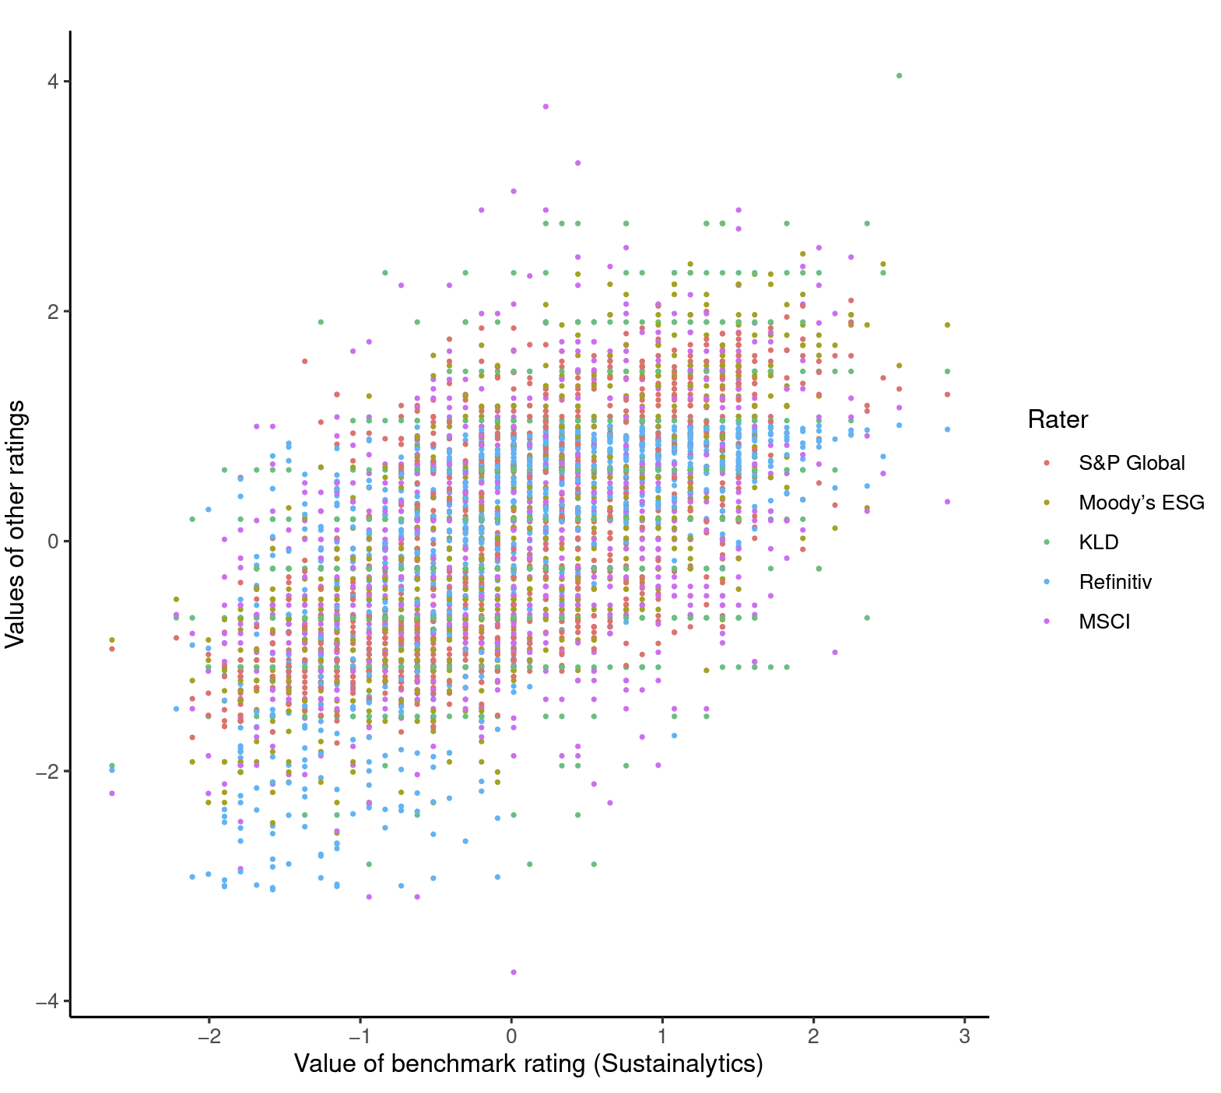
THE NEED FOR STANDARDIZATION
Dispersion of ratings 2 compared to benchmark ranges from -4x to 4x

Slide 5
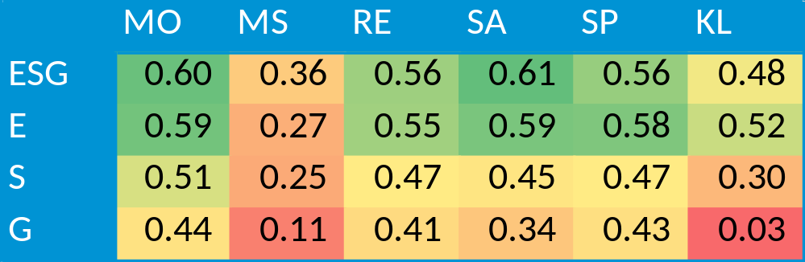
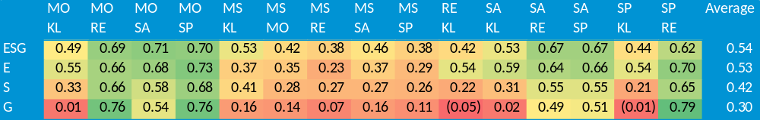
THE NEED FOR STANDARDIZATION
  AVERAGE PAIRWISE CORRELATION ⁴
Correlations between ratings providers are distressingly low
  PAIRWISE CORRELATIONS FOR E, S, G, AND ESG ³
Notes:
MSCI has the lowest correlation to the rest of the pack. Important because they have the largest share of the AM market. So, a lot of funds and ETFs will probably score differently than what the clients might expect.

Slide 6
MEASUREMENT DIVERGENCE
THE NEED FOR STANDARDIZATION
56%
When two firms use different indicators to measure the same attribute
(employee turnover vs labor litigation)
Average Source of Deviation ⁵
SCOPE DIVERGENCE
38%
When two firms use different attributes to form their rankings
(include lobbying or ignore it)
WEIGHTING DIVERGENCE
6%
When two firms attach different levels of importance to the same attribute
(how important is % women vs pay gap?)
Notes:
There are 64 common categories but over 700 different indicators across all vendors
MSCI uses a special indicator that describes how important that attribute is to an industry or specific company. Scope is therefore the largest contributor for that vendor only.

Slide 7
THE NEED FOR STANDARDIZATION
MITIGATION STRATEGIES
New entrants looking to plug the gaps
Many new entrants looking to address the issues of ESG specifically for wealth management.
One new firm is using consensus estimates in their ratings process for smoothing (OWL ESG). ⁶
Dig into the differences
Understand and be ready to explain the differences in ratings.
Understand which ratings provider fits the best with your client.
If you choose one provider, make sure you can defend the choice.
Produce simple, easy to understand sales collateral
Notes:
There are 64 common categories but over 700 different indicators across all vendors
MSCI uses a special indicator that describes how important that attribute is to an industry or specific company. Scope is therefore the largest contributor for that vendor only.

Slide 8






THE NEED FOR CUSTOMIZATION
Everyone’s ESG Preferences are different
A trust officer’s superpower is creating solutions for client problems and desires
The eventual category killer will be fully integrated
Importantly, it needs to be directly integrated into the portfolio construction and proposal systems.
Trust Officers need mass customization
Needs to be an easy process that is scalable, quick, and integrated into the trust officer’s normal processes
Need a method of portfolio construction
Realistically, it will have to be a technology solution
Can be as simple as selecting appropriate
funds in each bucket or as complicated as full portfolio optimizations.
Ideally, it will be incorporated directly into the trust officer’s normal portfolio creation and review software.
Need an easy, repeatable way to assess preferences
Perhaps a questionnaire similar to risk tolerance assessment.

Slide 9
THE NEED FOR CLARITY
Clients need to understand the proposal for themselves
Trust took a hit in 2008, but by offering intuitive validation, trust officers can help their clients move forward with confidence.
1-100 scale is simple enough, but what does it mean?
Is a 70 really 40% better than a 50?
Can be useful when trying to make a case for small trade-offs.
Real-world metrics are an intriguing solution
One firm translates ESG into “metaphor metrics” such as “Portfolio A kills 50,000 fewer chickens than Portfolio B” (YourStake.org)7
Notes:
There are 64 common categories but over 700 different indicators across all vendors
MSCI uses a special indicator that describes how important that attribute is to an industry or specific company. Scope is therefore the largest contributor for that vendor only.

Slide 10

Appoint an internal “ESG Officer”
A TACTICAL PLAN
Go-to internal resource for rapid response to a client request.
Understand the differences between vendors
Develop simple, easy to understand support collateral.
Lean on marketing and content to help
Content that shows you are serious, knowledgeable, and capable.
Pull out the purple rack
Notes:
There are 64 common categories but over 700 different indicators across all vendors
MSCI uses a special indicator that describes how important that attribute is to an industry or specific company. Scope is therefore the largest contributor for that vendor only.

Slide 11
REFERENCES
Global Sustainable Investment Alliance, 2020 Global Sustainable Investment Review (2021). http://www.gsi-alliance.org/wp-content/uploads/2021/08/GSIR-20201.pdf
Berg, Florian and Kölbel, Julian and Rigobon, Roberto, Aggregate Confusion: The Divergence of ESG Ratings (August 15, 2019). Forthcoming Review of Finance, Available at SSRN: https://ssrn.com/abstract=3438533 or http://dx.doi.org/10.2139/ssrn.3438533
Ibid
Ibid
Ibid
https://www.owlesg.com
https://www.yourstake.org
Notes:
There are 64 common categories but over 700 different indicators across all vendors
MSCI uses a special indicator that describes how important that attribute is to an industry or specific company. Scope is therefore the largest contributor for that vendor only.

