Slide 1












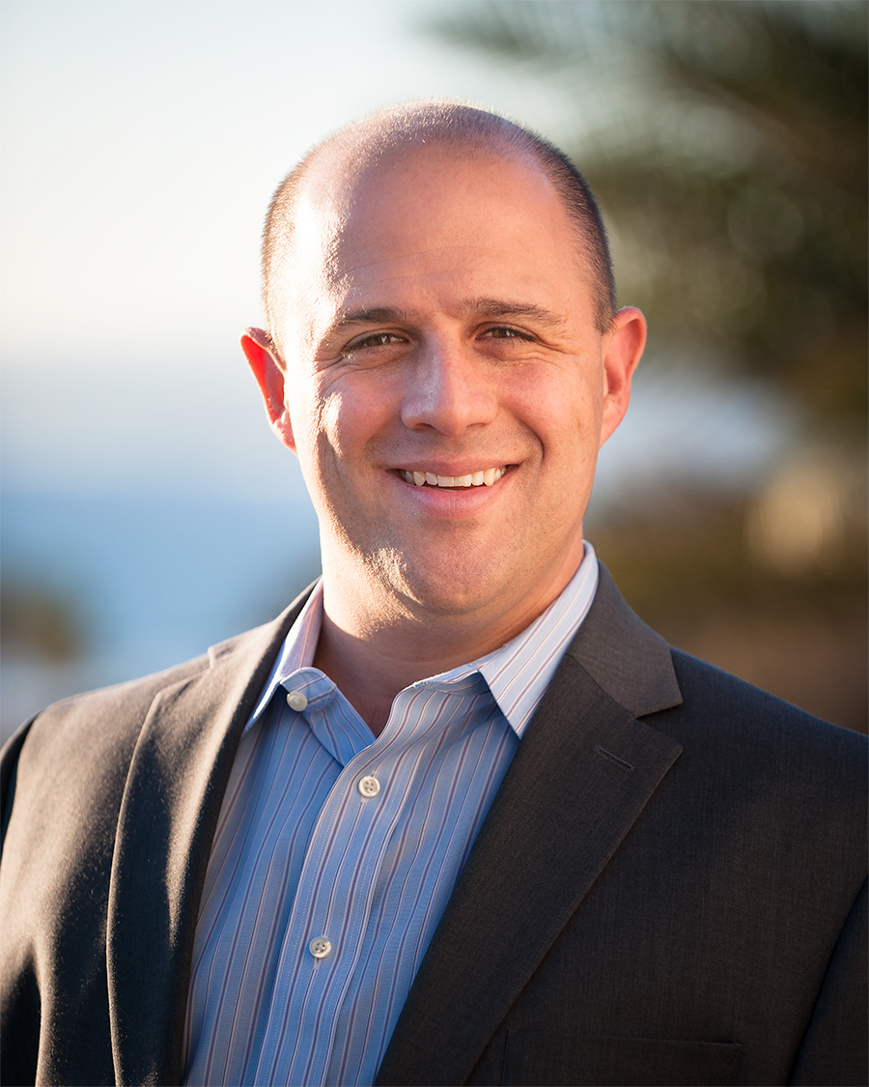




ESG Data Mgt race into Mainstream Investing
A conversation with
HEAD
SHOT
Ben Webster
CEO and Founder
OWL ESG
HEAD
SHOT
Joseph Mezrich
Founder
Metafoura

Slide 2
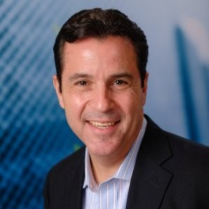
Moderated by Mike Meriton
Co-Founder, EDM Council
Joined EDM Council full-time in 2015 to lead Industry Engagement
EDM Council Co-Founder & First Chairman (2005-2007)
EDM Council Finance Board Chair (2007-2015)
Former CEO GoldenSource (2002-2015)
Former Executive for D&B Software and Oracle
FinTech Innovation Lab – Executive Mentor (2011 – Present)
EDM Council COO (2020-2023)

Slide 3
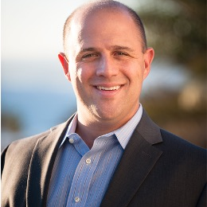
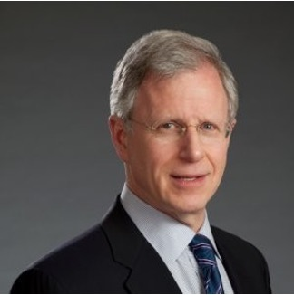
Today’s panel
Moderator
Mike Meriton
Co-Founder
EDM Council
Ben Webster
CEO
OWL ESG
Joseph Mezrich
Founder
Metafoura

Slide 4

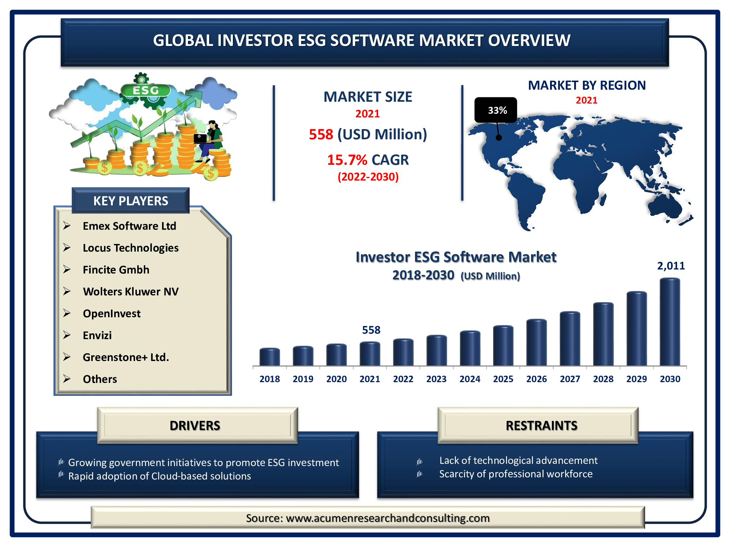
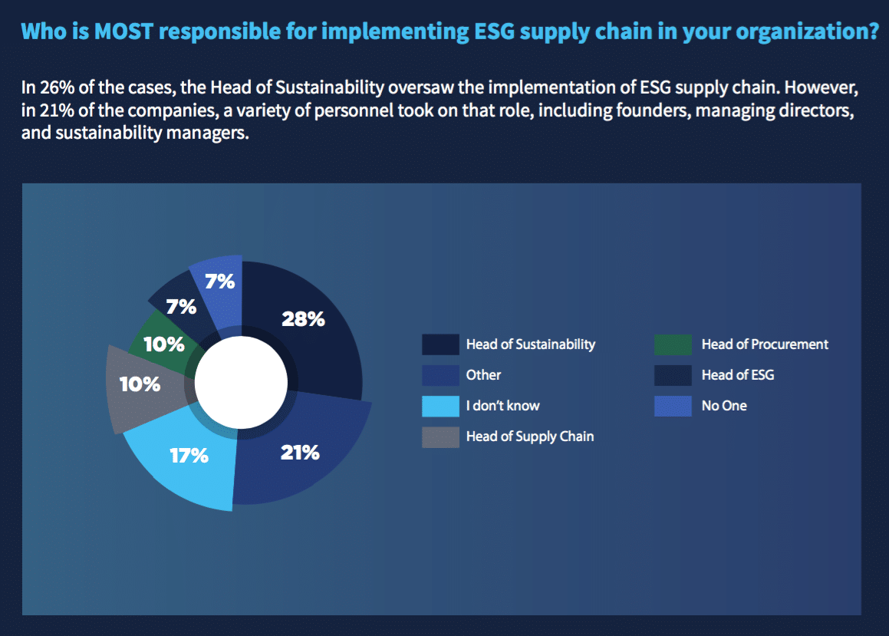
ESG on the Rise
91% of business leaders say they believe their company has a responsibility to act on ESG issues. (PWC)

Slide 5
Poll #1
In what way have you encountered ESG recently?
Through products
Investments
Strategic decisions
Other

Slide 6
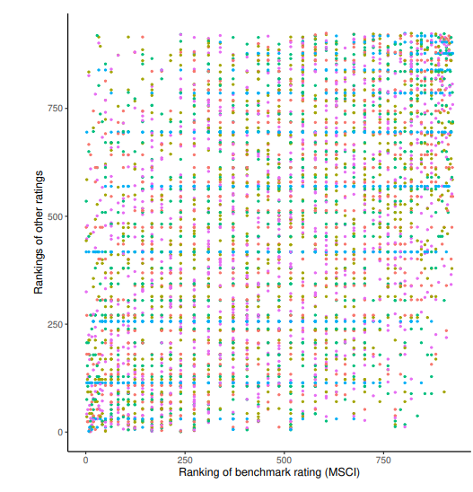
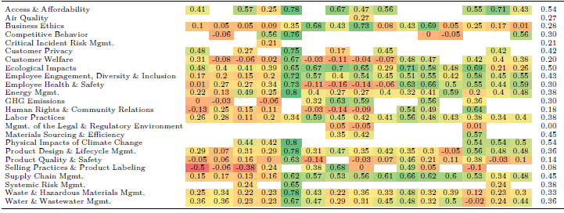
Data Debacle
Divergence in ESG Ratings Between Providers
Harvard and MIT Studies
56%
MEASUREMENT DIVERGENCE
38%
SCOPE DIVERGENCE
6%
WEIGHTING DIVERGENCE
OVERALL ESG SCORE:
~50%
RATING CORRELATION
COMMON ESG THEMES:
~33%
RATING CORRELATION
“…the more information a company discloses about its ESG practices, the more rating agencies disagree on how well that company is performing along these dimensions” – Harvard Business School

Slide 7
Data Debacle
“ESG is an unholy mess that needs to be ruthlessly streamlined. ESG has a measurement problem; the various scoring systems have gaping inconsistencies and are easily gamed.” – The Economist

Slide 8
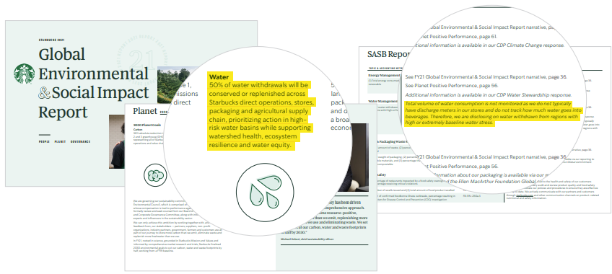
Data Debacle
Researchers at Columbia University and London School of Economics compared the ESG record of U.S. companies in 147 ESG fund portfolios and that of U.S. companies in 2,428 non-ESG portfolios. They found that the companies in the ESG portfolios had worse compliance record for both labor and environmental rules.

Slide 9
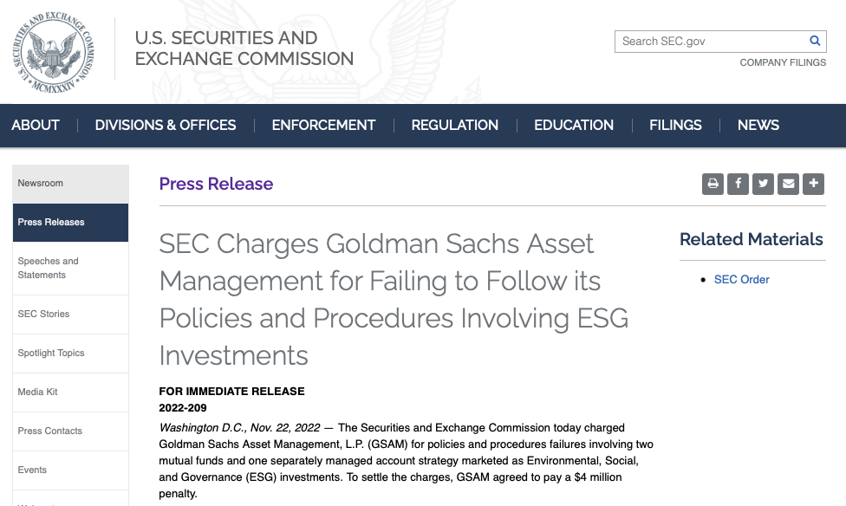
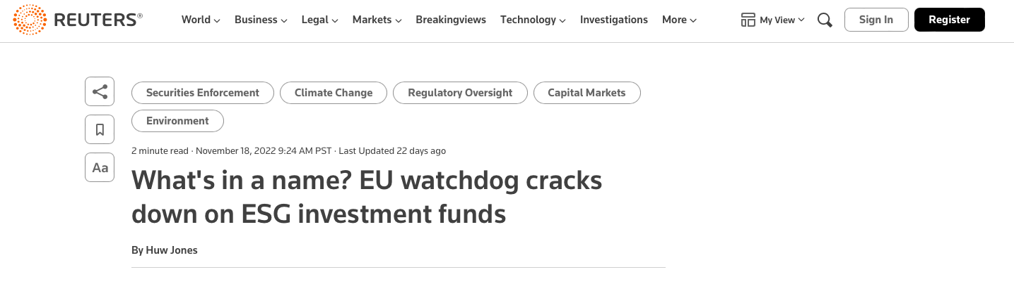
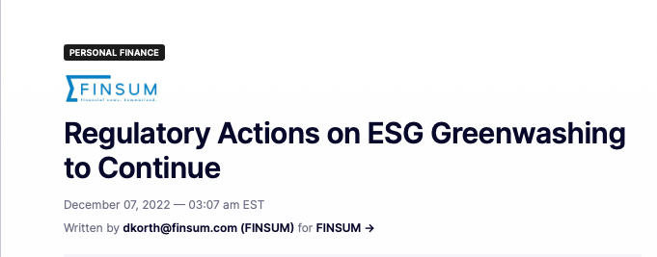
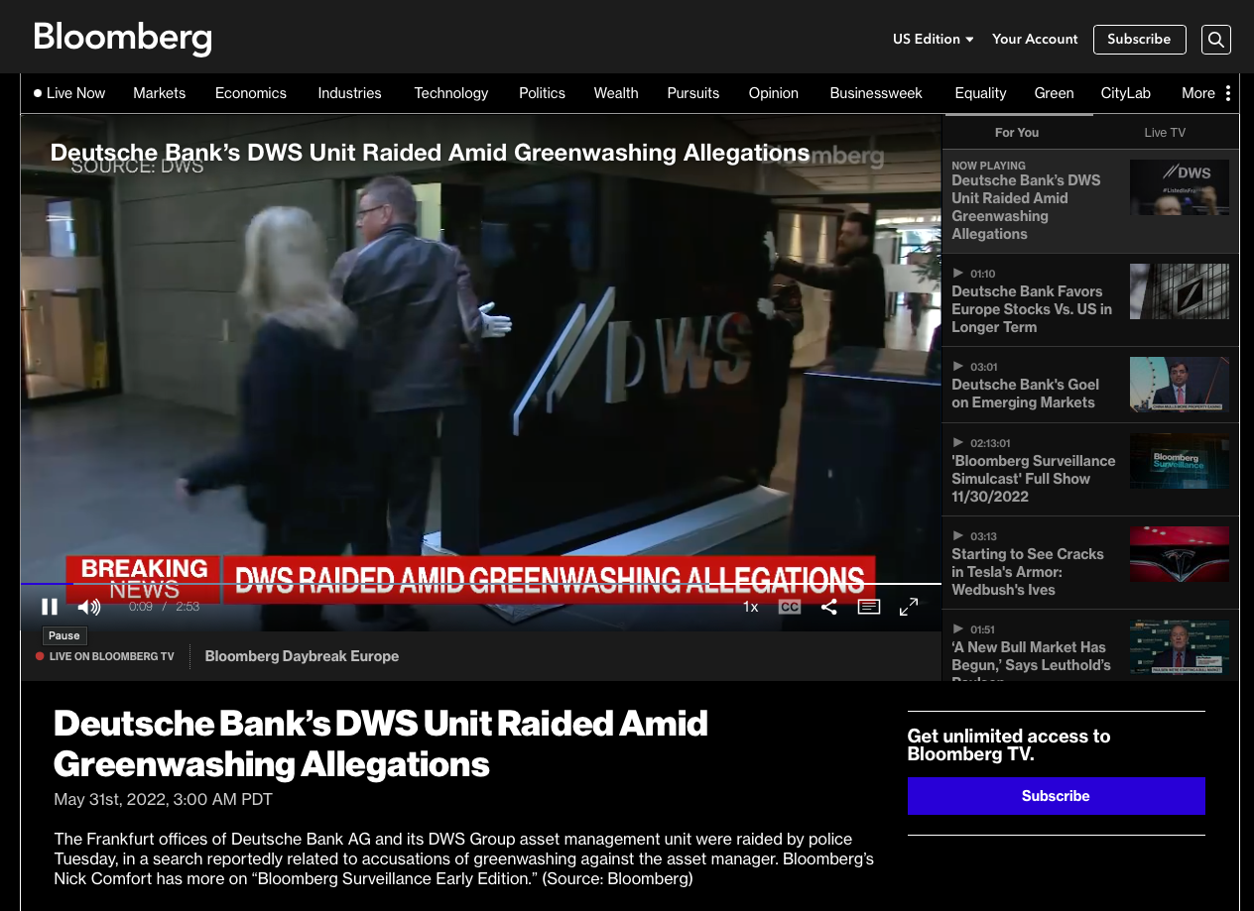
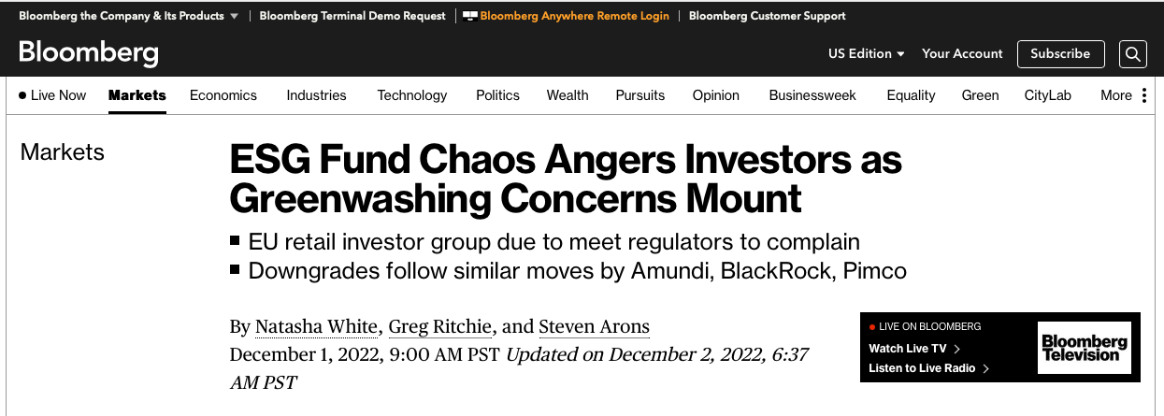
Data Debacle
“To prevent dishonest climate accounting and other actions designed to circumvent the need for deep decarbonization, we emphasize that non-state actors must report publicly on their progress with verified information that can be compared with peers.” -Catherine McKenna, U.N.
Chair, High-level Expert Group on the Net Zero Emissions Commitments of Non-State Entities

Slide 10
Poll #2
How confident are you that your investments and portfolios are aligned with the ESG goals they claim to accomplish?
Not at all confident
Somewhat confident
Moderately confident
Highly confident

Slide 11
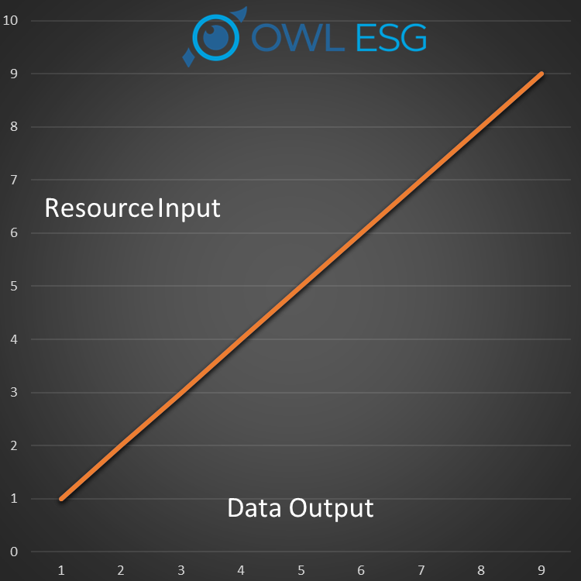


Data Debacle
83% of consumers think companies should be actively shaping ESG best practices and 86% of employees prefer to support or work for companies that care about the same issues they do.

Slide 12

A Potential Solution?
AI Is Revolutionizing ESG Data
AI language comprehension models are able to extract data far more accurately and quickly than humans
AI can be applied at scale, allowing everyone from institutional investors to corporate consultants freedom from the tethers of today’s constraints
AI can be customized to create content and generate analysis and insights that fit the user’s needs.
“I am telling you, the world’s first trillionaires are going to come from somebody who masters AI and all its derivatives and applies it in ways we never thought of.” – Mark Cuban

Slide 13
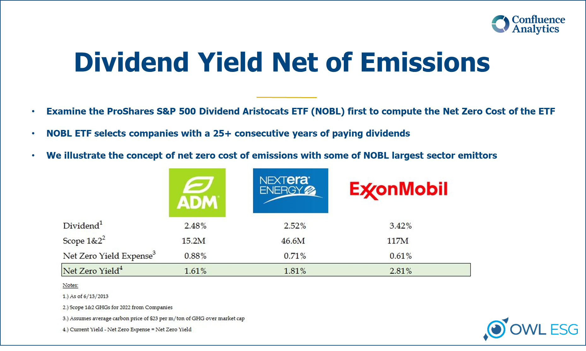
Sustainability is Long-Term Strategy
“ESG has become perhaps the most powerful driver of growth in asset and wealth management.”
- Olwyn Alexander, PwC Global Asset & Wealth Management Leader

Slide 14
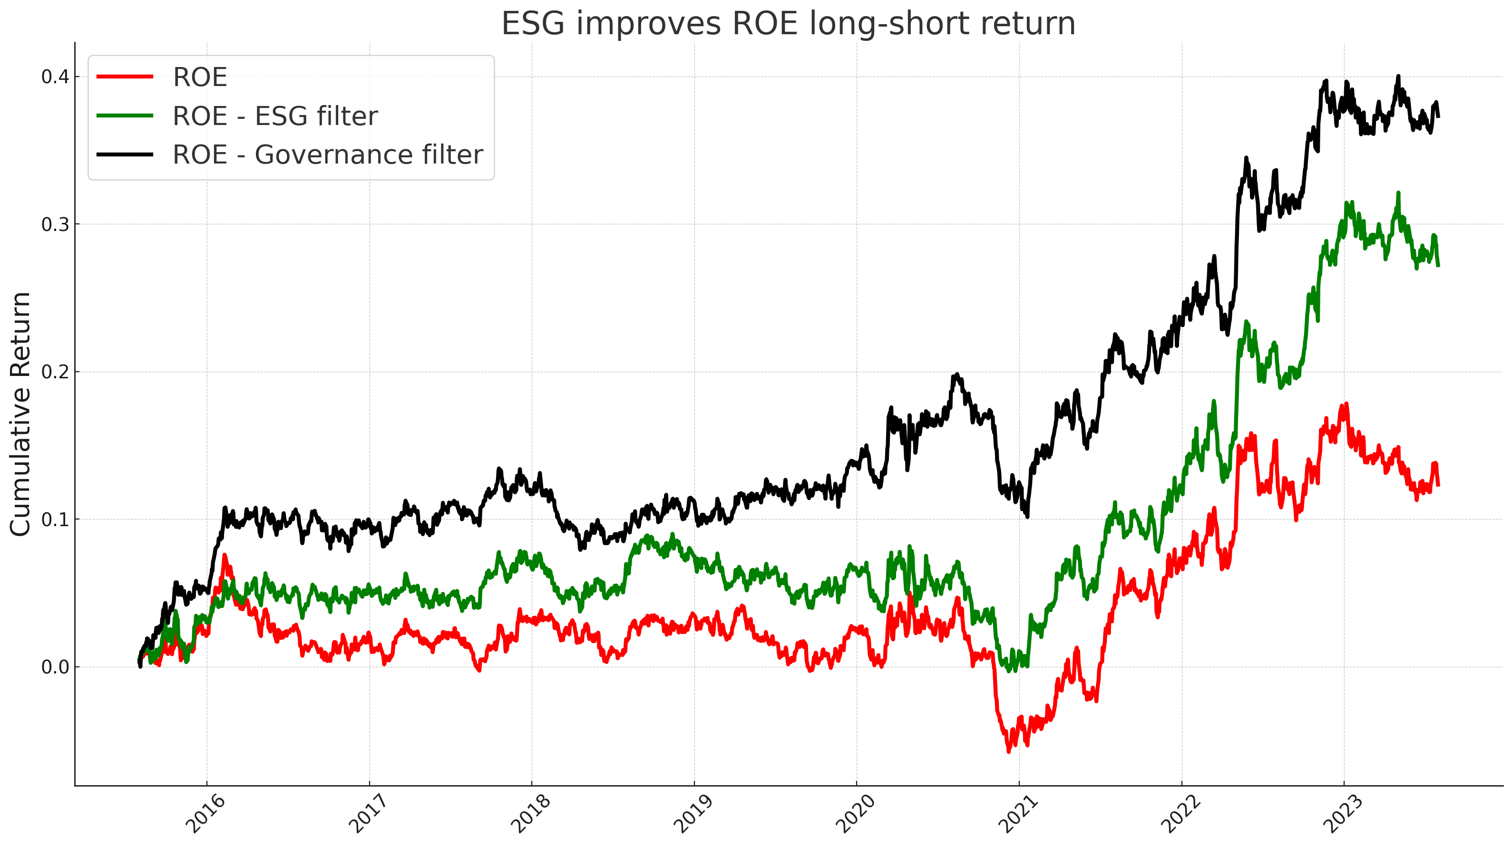
Sustainability is Long-Term Strategy
Pre-Pandemic
ROE Filtered by OWL’s ESG and Governance Scores
“Other than earnings and sales, ROE is among the most important criteria for investors to look at before investing in growth stocks.” –Investor’s Business Daily

Slide 15
Sustainability is Long-Term Strategy
Passive Investing Can Be ESG Optimized
Source: Metafoura, OWL Analytics, FactSet, Finsera
“In fact, ESG index funds may help investors manage downside risk better than traditional index funds.” –World Resources Institute

Slide 16
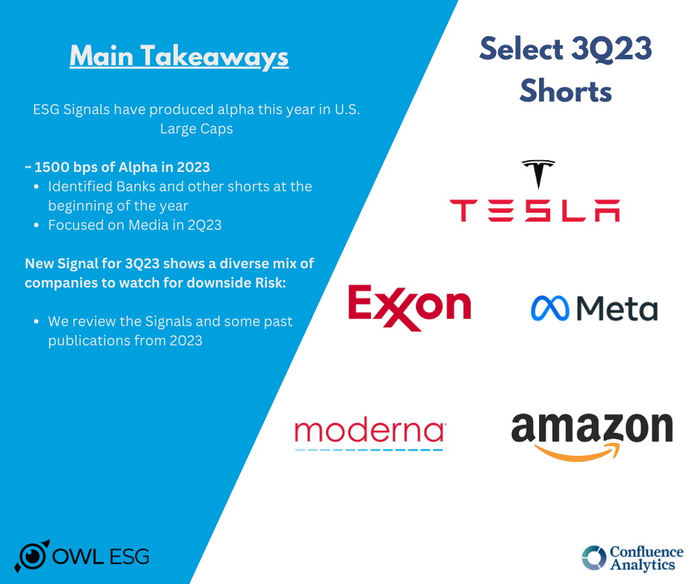
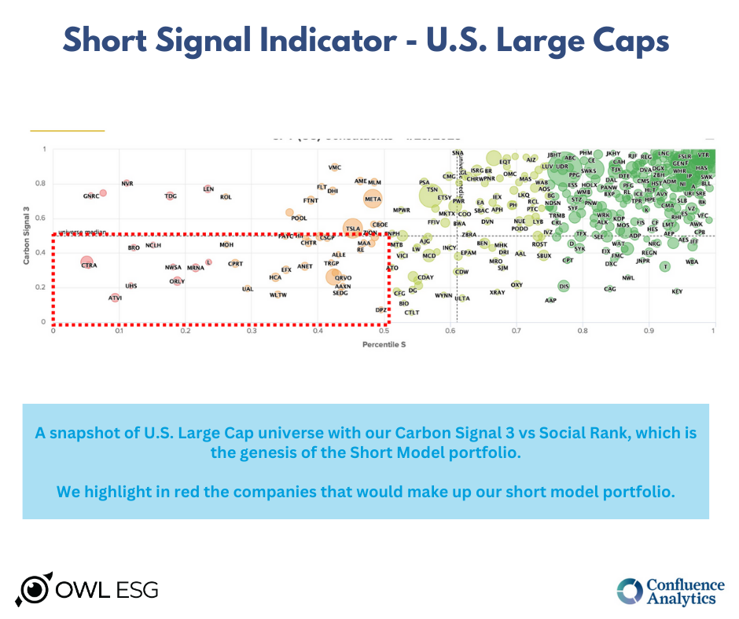
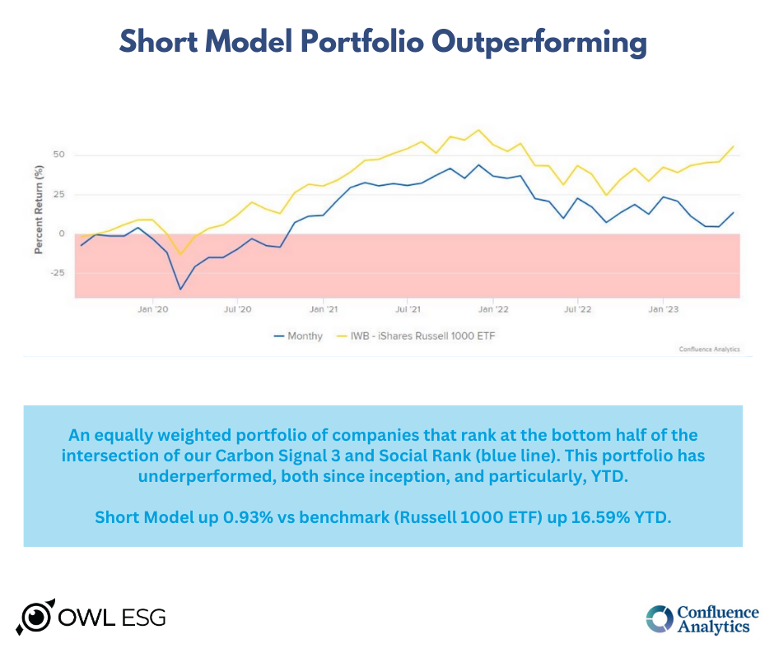
Sustainability is Long-Term Strategy
“…shorting may be a great way to hedge risks, including those of an ESG nature.” -AQR

Slide 17
Questions?
YOUR LOGO HERE

Slide 18
Never Have I Ever
If you have ever…
Been provided with inaccurate or stale data
Wasted valuable time checking reports for accuracy
Spent too much money on data sets or data collection
Had resources dedicated solely to reviewing new filings
Watched talent bogged down in rote data tasks
If you have ever struggled with your data…

Slide 19
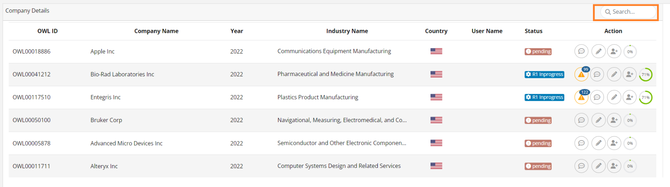
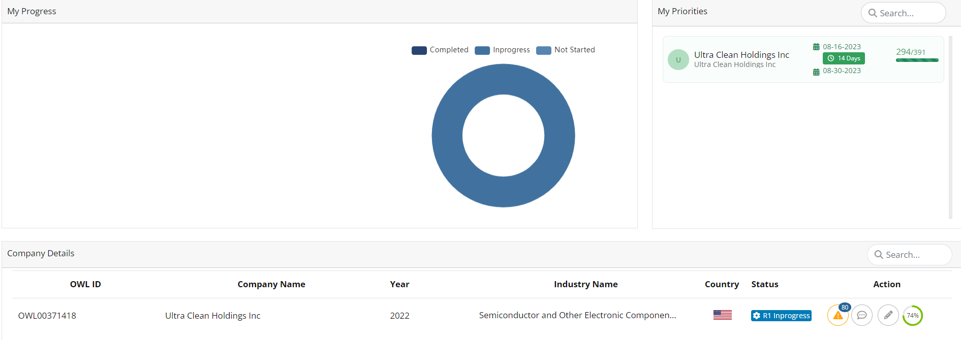

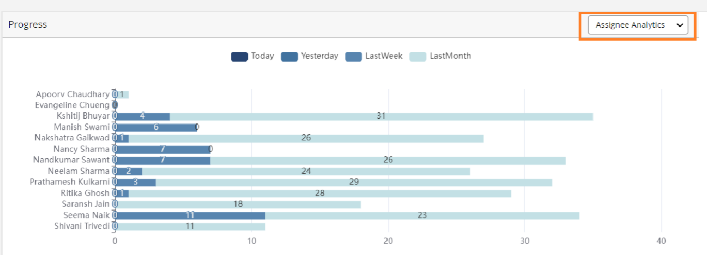
Introducing OWL’s Deep Research Application
…We can help
The world’s first AI-powered ESG research platform.
It’s this simple.
We are giving you the gift of your time back.

Slide 20
Sustainability is Long-Term Strategy
SaaS
DEEP RESEARCH APPLICATION
Leverage the power of AI for primary ESG research, turning an analyst into a team and a team into an army
INSTITUTIONAL INVESTOR
PORTAL
All the analytics for your portfolio construction and reporting, at your fingertips, using the most accurate, freshest data
PEER ANALYTICS
Compare and contrast companies against their peers across numerous and custom peer baskets to quickly gain insight and actionability

Slide 21

Rob Yates
Director of Communications
OWL ESG, Inc.
571-21-1281
ryates@OWLesg.com
Mark T. Garofalo
Managing Director
OWL ESG, Inc.
301.795.8575
Mgarofalo@OWLesg.com
This document and all of the information contained in it, including without limitation all text, data, graphs, and charts (collectively, the "Information") is the property of OWL ESG Inc. (OWL).
The Information has not been submitted to, nor received approval from, the United States Securities and Exchange Commission or any other regulatory body. None of the Information constitutes an offer to sell (or a solicitation of an offer to buy), or a promotion or recommendation of, any security, financial product or other investment vehicle or any trading strategy, and OWL does not endorse, approve, or otherwise express any opinion regarding any issuer, securities, financial products or instruments or trading strategies.
The user of the Information assumes the entire risk of any use it may make or permit to be made of the Information. OWL MAKES NO EXPRESS OR IMPLIED WARRANTIES OR REPRESENTATIONS WITH RESPECT TO THE INFORMATION AND EXPRESSLY DISCLAIMS ALL IMPLIED WARRANTIES (INCLUDING, WITHOUT LIMITATION, ANY IMPLIED WARRANTIES OF ORIGINALITY, ACCURACY, TIMELINESS, NON-INFRINGEMENT, COMPLETENESS, MERCHANTABILITY, AND FITNESS for A PARTICULAR PURPOSE) WITH RESPECT TO ANY OF THE INFORMATION.
Without limiting any of the foregoing and to the maximum extent permitted by law, in no event shall OWL have any liability regarding any of the Information for any direct, indirect, special, punitive, consequential (including lost profits), or any other damages even if notified of the possibility of such damages. The foregoing shall not exclude or limit any liability that may not by applicable law be excluded or limited.
Notes:
Wise

Slide 22

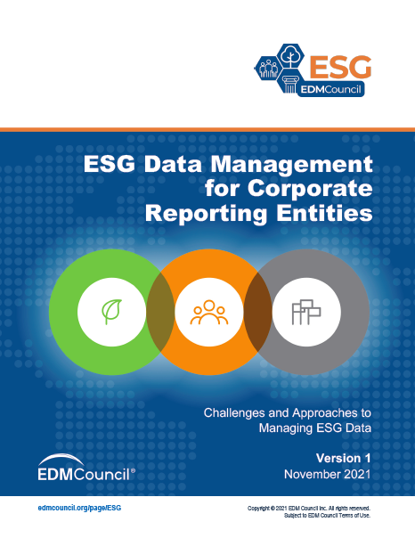
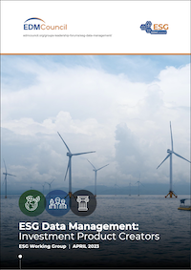
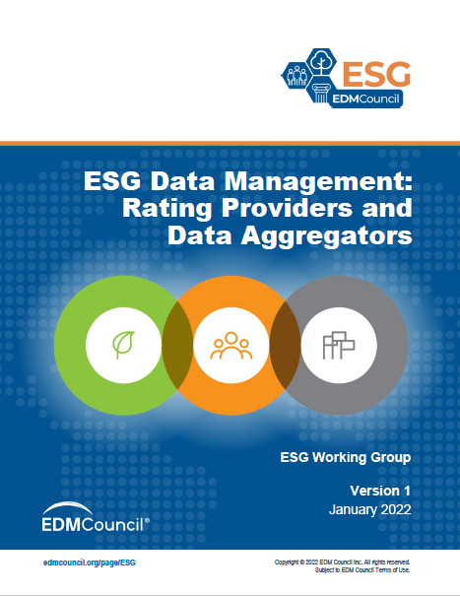
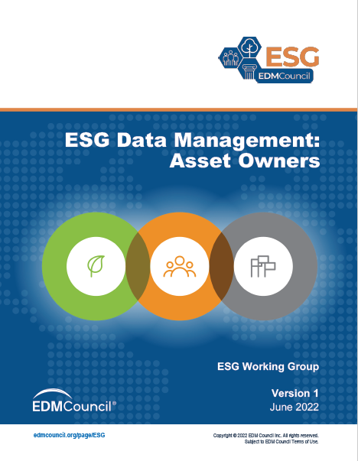
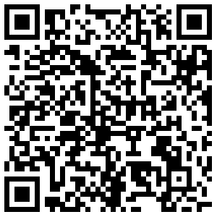
EDM Council – ESG Data Workgroup Reports
Download ESG Data Management guidelines for:
Corporate Reporting Entities
Investment Product Creators
Ratings Providers and Data Aggregators
Asset Owners
Free license – download at:
www.edmcouncil.org
Go to Engage > Groups > ESG Data

Slide 23
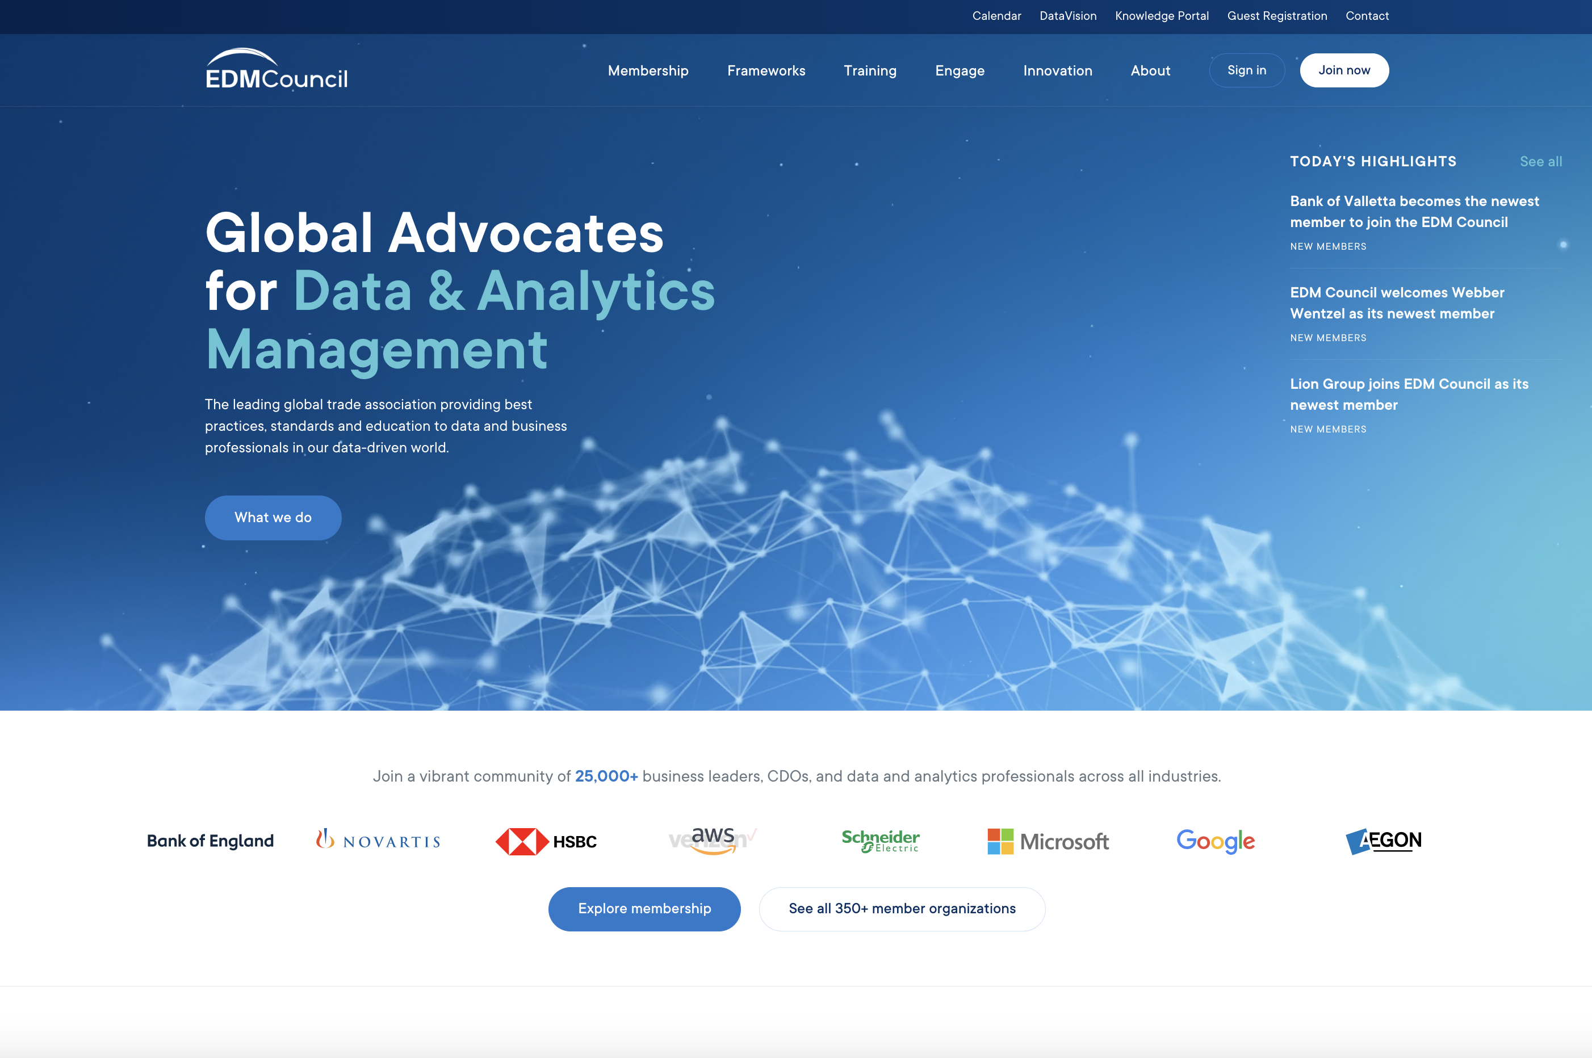



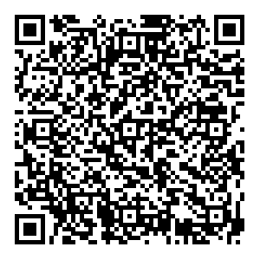

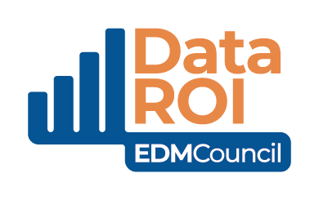



Join EDM Council and our membership
community of companies…
350+ Member Firms
Cross-industry,
including Regulators
25,000+
Professionals
Worldwide
Americas, Europe, Africa, Asia, Australia
edmcouncil.org

Slide 24
Thank you!
FOR MORE INFORMATION:
Rob Yates
Director of Communications
OWL ESG
Communications@owslesg.com

