Slide 1


The Coming ESG Rush
And why it doesn’t matter (yet).

Slide 2



Introduction
Ben Webster
Founder & CEO
ESG Data & Analytics Expert. 9+ years of working with large asset managers on ESG investment products. 20+ years sales & management experience in the financial services industry with a strong focus on selling into asset management and family offices on behalf of hedge & real estate funds.
UCLA, Bachelors in Physics
2

Slide 3
Today’s Discussion – Past, Present, and Future
Opening the History Books –
ESG Data and How We Got Here
Temperature Check –
The Decidedly Unsustainable Current State of ESG Data
Looking Into a Crystal Ball –
The Coming ESG Explosion and Where OWL Fits In
Q&A
This document and all of the information contained in it, including without limitation all text, data, graphs, and charts (collectively, the "Information") is the property of OWL ESG Inc. (OWL).
The Information has not been submitted to, nor received approval from, the United States Securities and Exchange Commission or any other regulatory body. None of the Information constitutes an offer to sell (or a solicitation of an offer to buy), or a promotion or recommendation of, any security, financial product or other investment vehicle or any trading strategy, and OWL does not endorse, approve, or otherwise express any opinion regarding any issuer, securities, financial products or instruments or trading strategies.
The user of the Information assumes the entire risk of any use it may make or permit to be made of the Information. OWL MAKES NO EXPRESS OR IMPLIED WARRANTIES OR REPRESENTATIONS WITH RESPECT TO THE INFORMATION AND EXPRESSLY DISCLAIMS ALL IMPLIED WARRANTIES (INCLUDING, WITHOUT LIMITATION, ANY IMPLIED WARRANTIES OF ORIGINALITY, ACCURACY, TIMELINESS, NON-INFRINGEMENT, COMPLETENESS, MERCHANTABILITY, AND FITNESS for A PARTICULAR PURPOSE) WITH RESPECT TO ANY OF THE INFORMATION.
Without limiting any of the foregoing and to the maximum extent permitted by law, in no event shall OWL have any liability regarding any of the Information for any direct, indirect, special, punitive, consequential (including lost profits), or any other damages even if notified of the possibility of such damages. The foregoing shall not exclude or limit any liability that may not by applicable law be excluded or limited.
3

Slide 4
Part 1– The Past
Opening the History Books
ESG Data and How We Got Here
4

Slide 5
ESG on the Rise
Environmental, Social, and Governance
“ESG is a framework that helps stakeholders understand how an organization is managing risks and opportunities related to environmental, social, and governance criteria.” (Corporate Finance Institute)
Has existed conceptually in the market for almost a century.
Was originally driven by activist investors focused less on financial returns.
Has become a mainstream consideration, with attention and expenditures increasing significantly every year since 2010.

Slide 6
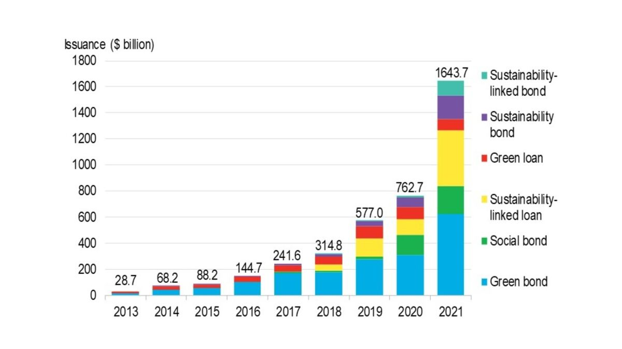
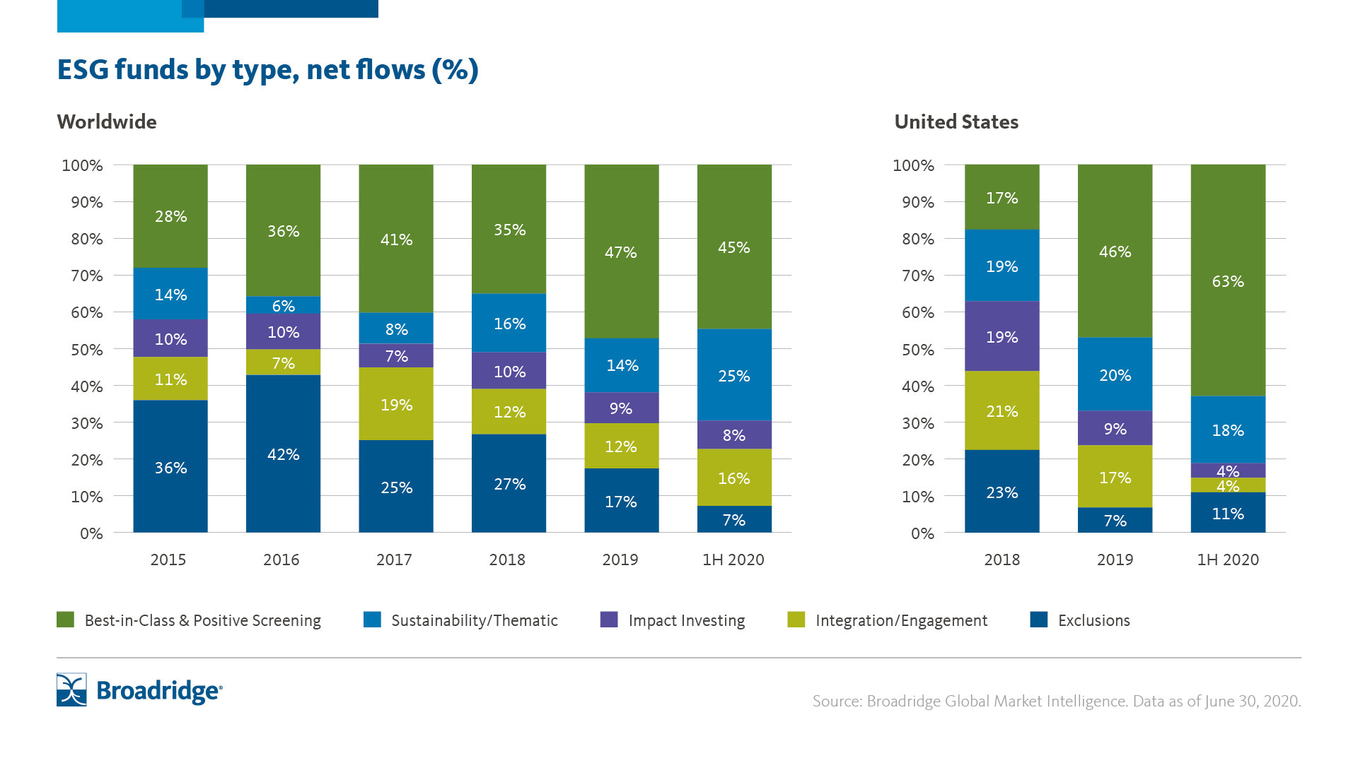
ESG on the Rise
As of the end of 2020, over $30 Trillion was invested in ESG-related assets under management (AUM)
Expected to reach $50 Trillion by 2025
More than 550 ESG-dedicated investment vehicles (funds, ETFs, etc.) as of 2022
Retail wealth ESG AUM up 92 percent from 2015-2019 (S&P 500 up 40 percent)
95 percent of millennial investors interested in sustainable investments
More than $70 Trillion in inheritance wealth transfer projected by 2035

Slide 7
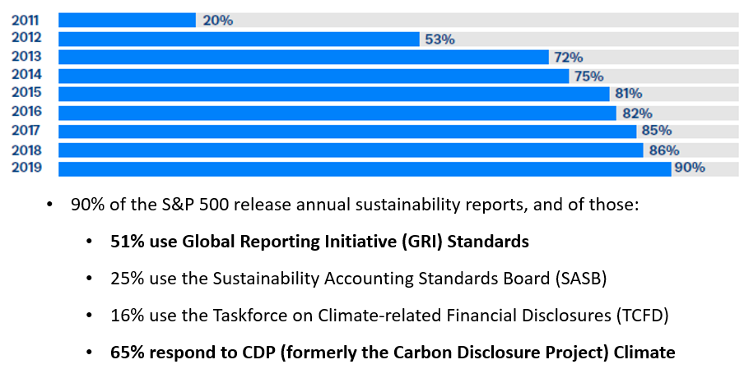
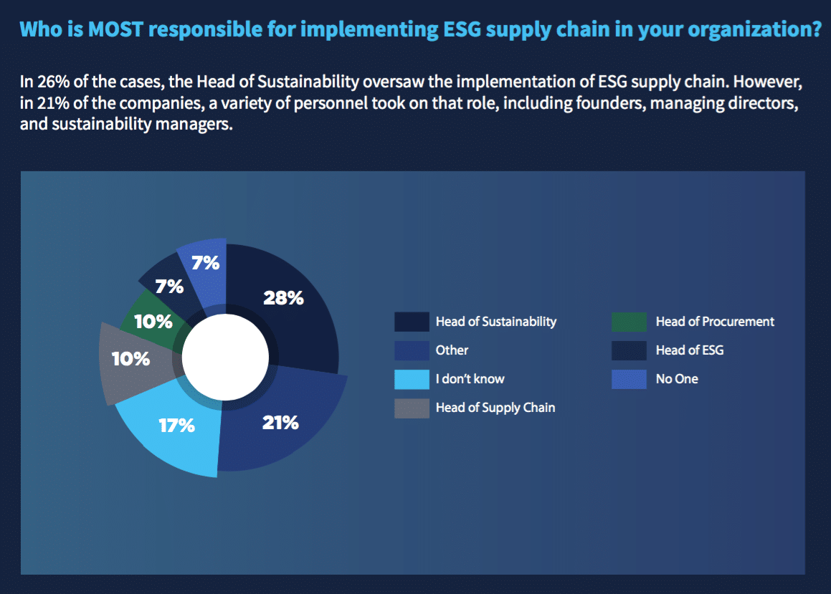
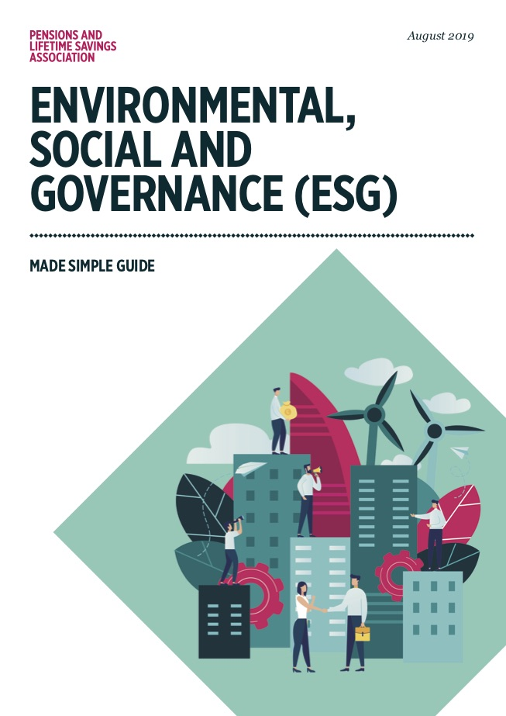
ESG on the Rise
83% of consumers think companies should be actively shaping ESG best practices and 86% of employees prefer to support or work for companies that care about the same issues they do.
91% of business leaders say they believe their company has a responsibility to act on ESG issues. (PWC)

Slide 8
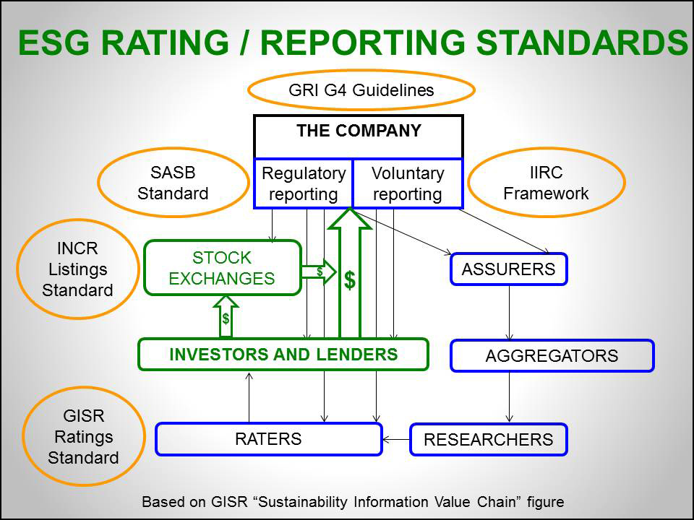
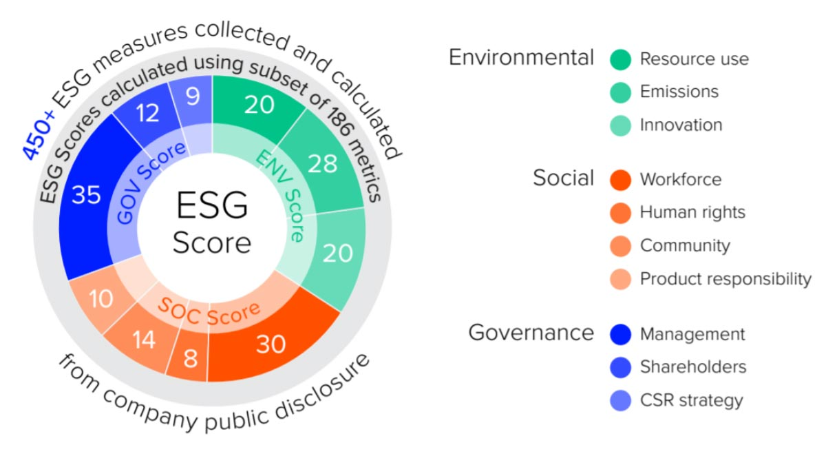
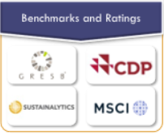
ESG on the Rise

Slide 9
Part 2 – The Present
Temperature Check
The Decidedly Unsustainable Current State of ESG Data
9

Slide 10
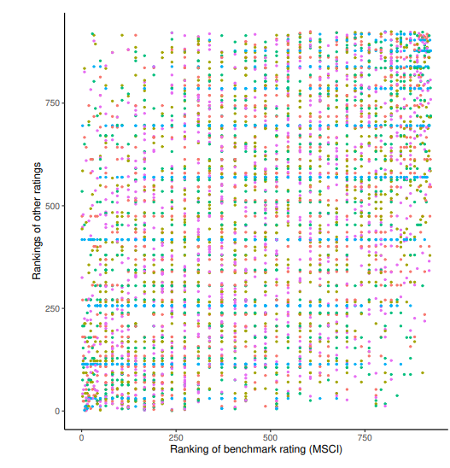
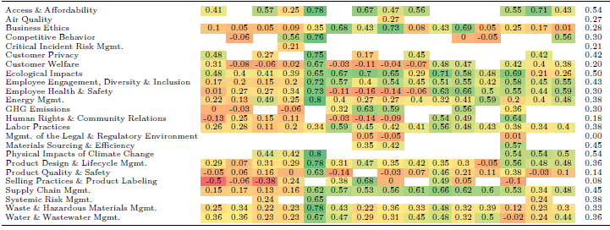
Data Debacle
Subjectivity Drives Scores
MEASUREMENT DIVERGENCE
Divergence in ESG Ratings Between Providers
Harvard and MIT Studies
56%
When two firms use different indicators to measure the same attribute
(employee turnover vs labor litigation)
SCOPE DIVERGENCE
38%
When two firms use different attributes to form their rankings
(include lobbying or ignore it)
WEIGHTING DIVERGENCE
6%
When two firms attach different levels of importance to the same attribute
(how important is % women vs pay gap?)
OVERALL ESG SCORE:
~50%
RATING CORRELATION
COMMON ESG THEMES:
~33%
RATING CORRELATION

Slide 11

Data Debacle
The Macro Challenges with ESG Data
  Qualitative Data Set
  Human Capital Intensive
  Long Lag Times
  Inconsistencies
  Unverifiable
ESG data is text-based, qualitative in nature, and often requires judgement
Data collection processes at large vendors are heavily dependent upon human capital
Rating firms are unable to update new company disclosures on a timely basis
Data disclosed by companies is self-reported and non-standardized
The data source is often non-traceable and not-disclosed to the user
Not all data is good data

Slide 12



Data Debacle
Company CSR Reports
2022 CSR Report Published
2023 CSR Report Published
2022 Jan Feb Mar Apr May June July Aug Sept Oct Nov Dec Jan Feb Mar Apr May June July Aug Sept Oct Nov Dec 2023
16 Month Lag Between ESG Updates by ABC Rating Firm
2022 ESG Rating Firm
Published Report
2023 ESG Rating Firm
Published Report
The majority of ESG data is manually collected via human data-entry from two computer screens:
Human data collection is slow +
Accuracy rates range 75 to 80%

Slide 13
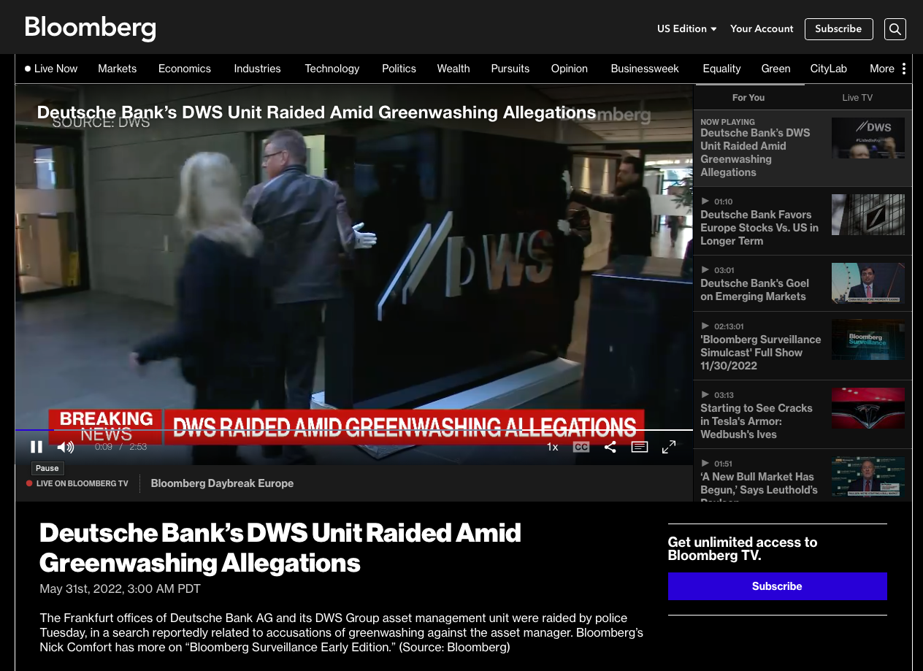
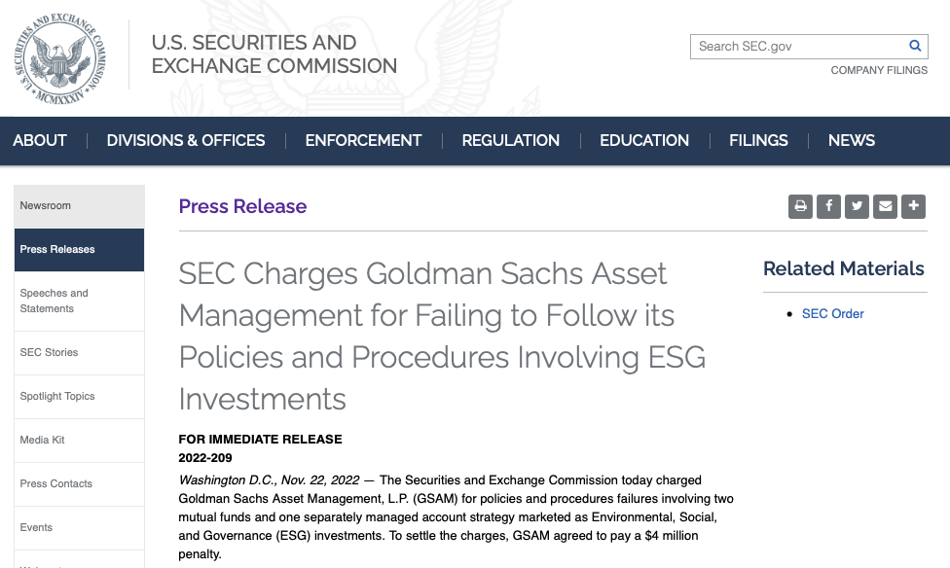
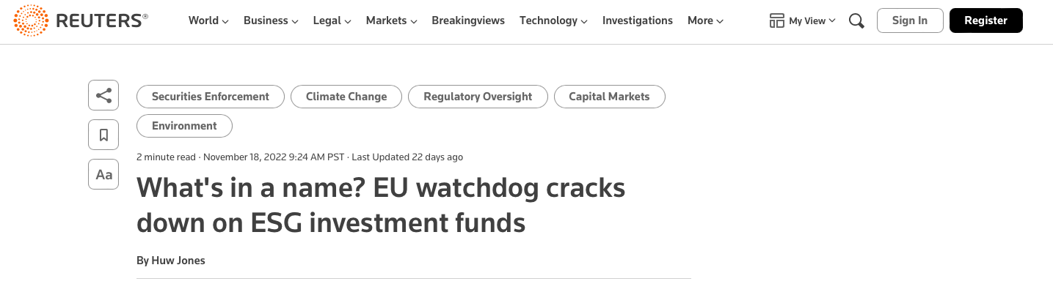
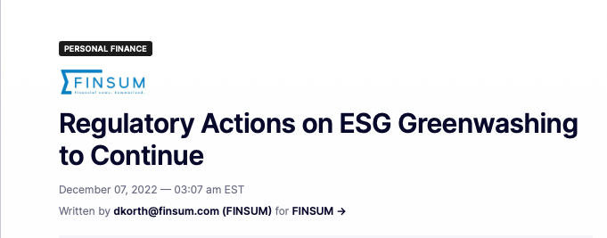
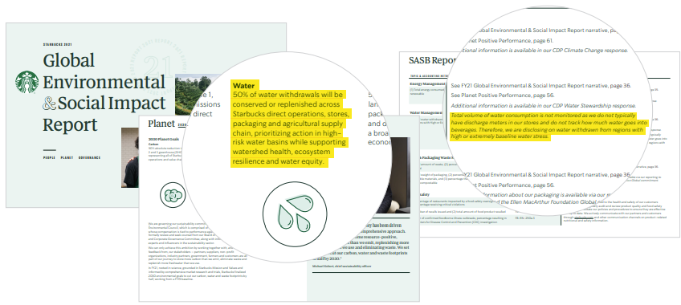
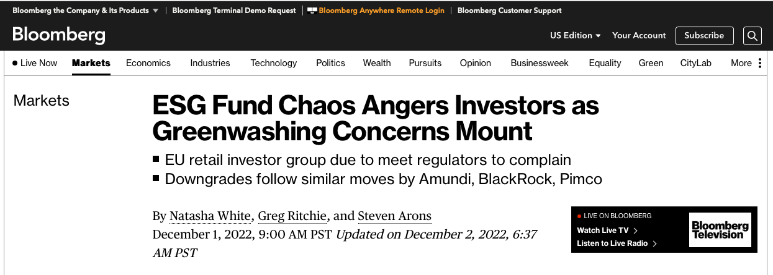
Data Debacle

Slide 14
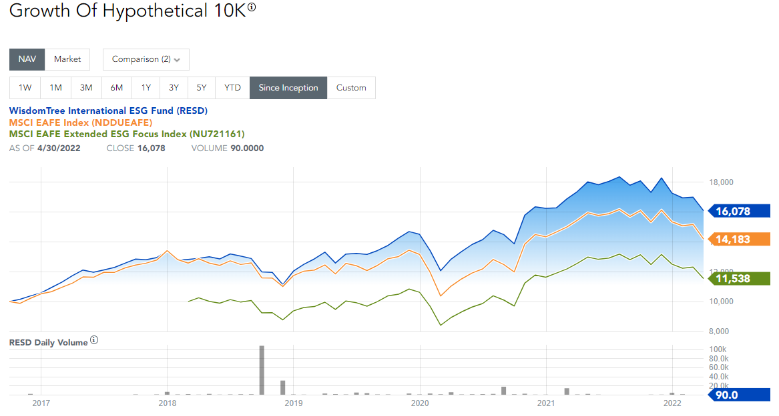
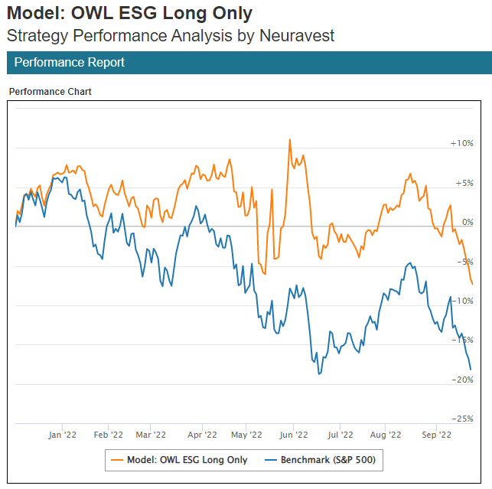
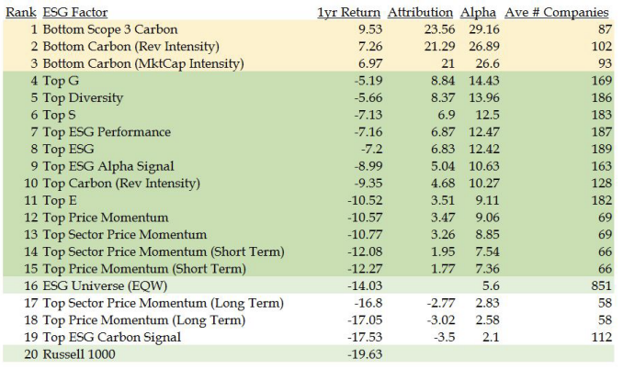
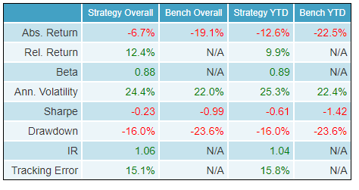
ESG on the Rise
2017 2018 2019 2020 2021 2022

Slide 15
Part 3 – The Future
Looking Into a Crystal Ball
The Coming ESG Explosion and Where OWL Fits In
15

Slide 16
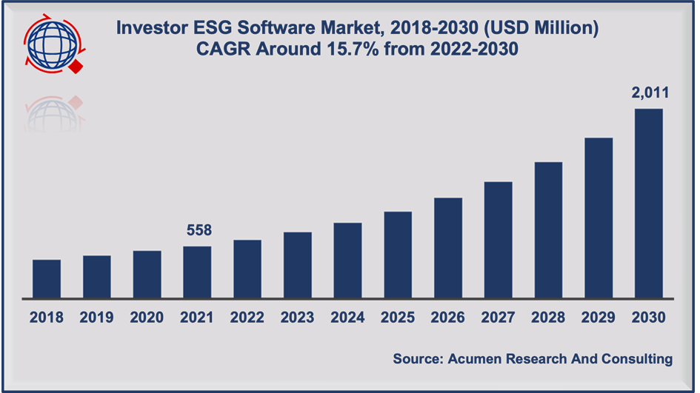
Sustainability is Long-Term Strategy
+26% Projected CAGR 2022-2025
$1.4m Annual average spend by institutional investors on ESG data
99% of public companies expect to invest in ESG reporting tech and tools in the next 12 months
“ESG has become perhaps the most powerful driver of growth in asset and wealth management.” - Olwyn Alexander, PwC Global Asset & Wealth Management Leader
64% of asset managers believe data challenges are a main obstacle when adopting or considering ESG investments.

Slide 17
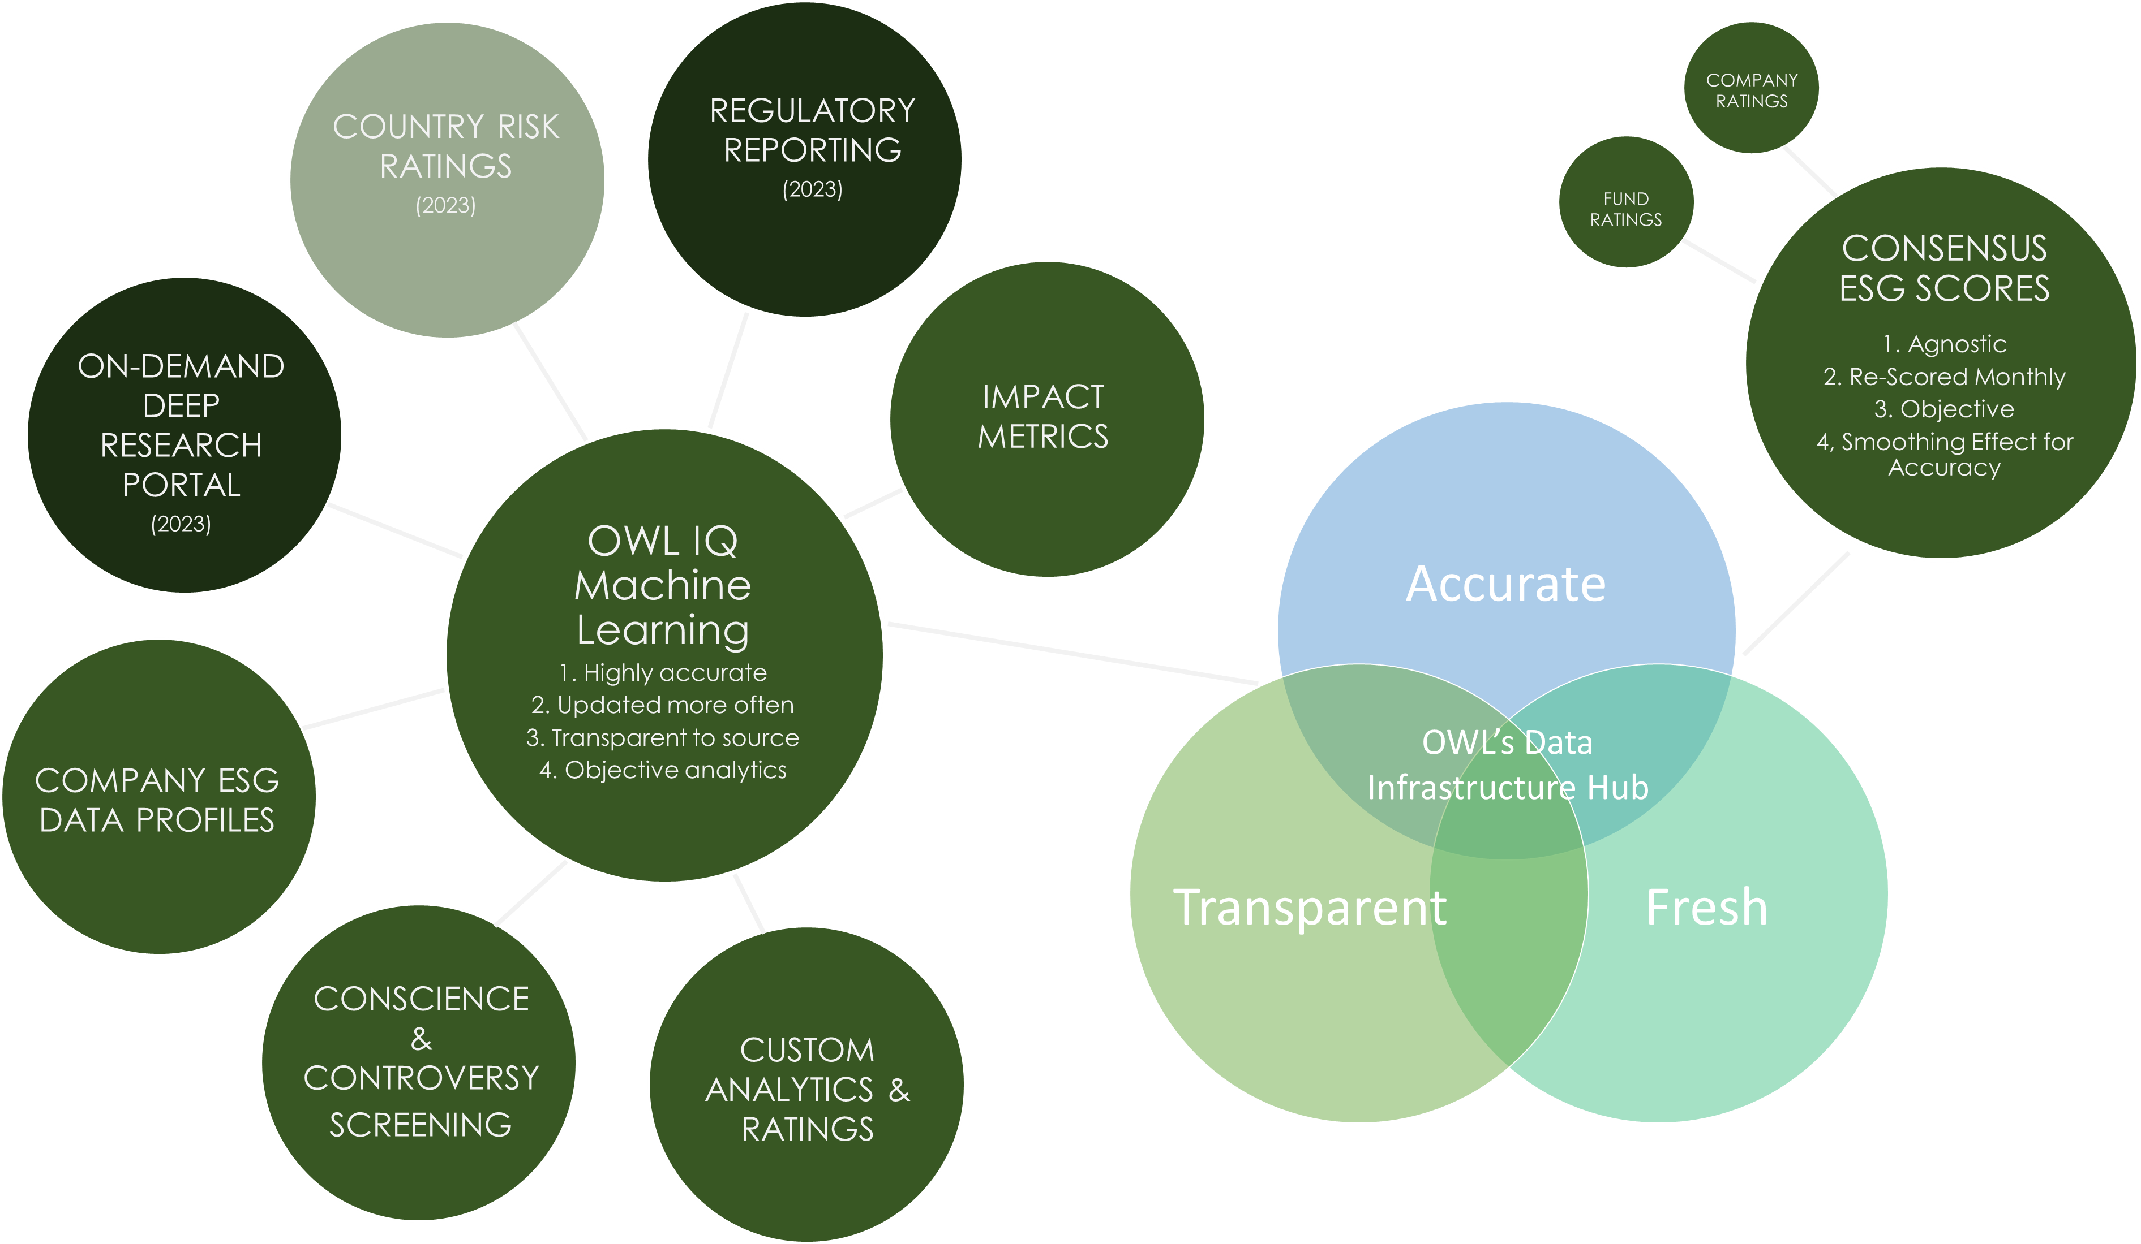
Sustainability is Long-Term Strategy

Slide 18

Sustainability is Long-Term Strategy
OWL IQ’s Model is Trained with the Ability to Read, Understand, Reason, and Answer Questions like a Human
The Machine Learning Model is trained based upon the data “tagging” collection policy
Repeat
Model Reinforcement Learning from Human Feedback Loop (RLHF)
Deploy ESG data collection with
tagging by humans
Deploy ESG data collection
with
tagging by machine
CHANGES made to the data collection policy
Data collection policy CONFIRMED
Tagged data is scored for accuracy
(human vs. machine)
Tagged accuracy scores drive the optimization & model improvement
Training
Learning

Slide 19
Sustainability is Long-Term Strategy
Final Thoughts:
There are real problems our world is facing that require real solutions.
The current market structure is not going to be able to address these challenges effectively.
ESG data is set to become the most valuable asset in this transition.
The market doesn’t need more ESG solutions, but better solutions.
Technology will have to develop to fill this void.
Accuracy, objectivity, recency, and transparency are the hallmarks of useful ESG data.

Slide 20
Thank you for listening
Q&A
www.owlesg.com
20

