Slide 1


Deep Research Application
User Quick Guide
Version 1.1

Slide 2
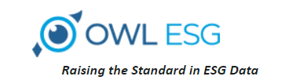
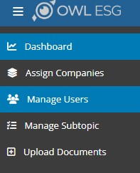
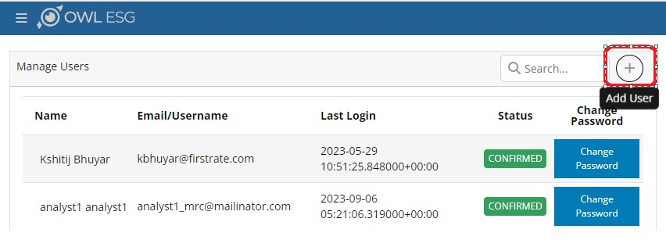
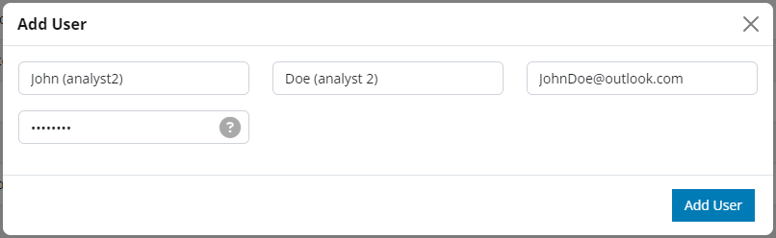
DRA Administration
Adding an Analyst
Assigning Company to an Analyst
Tracking Analyst Progress

Slide 3
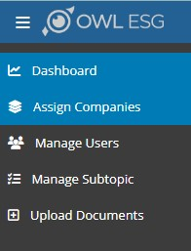
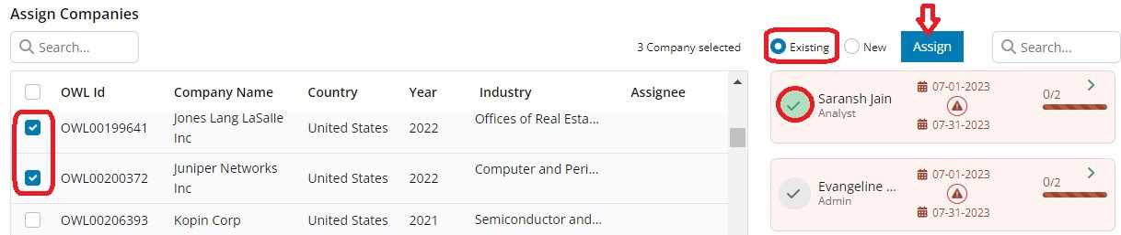
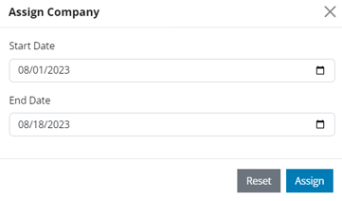
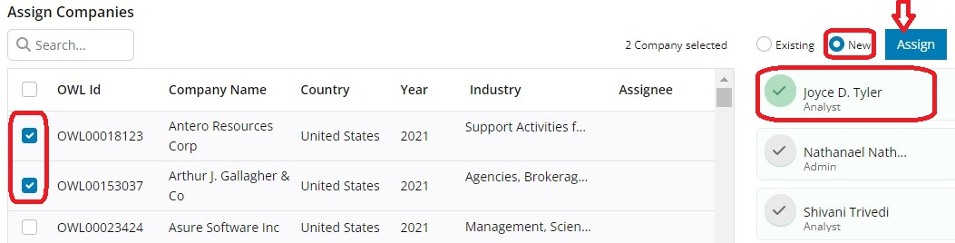
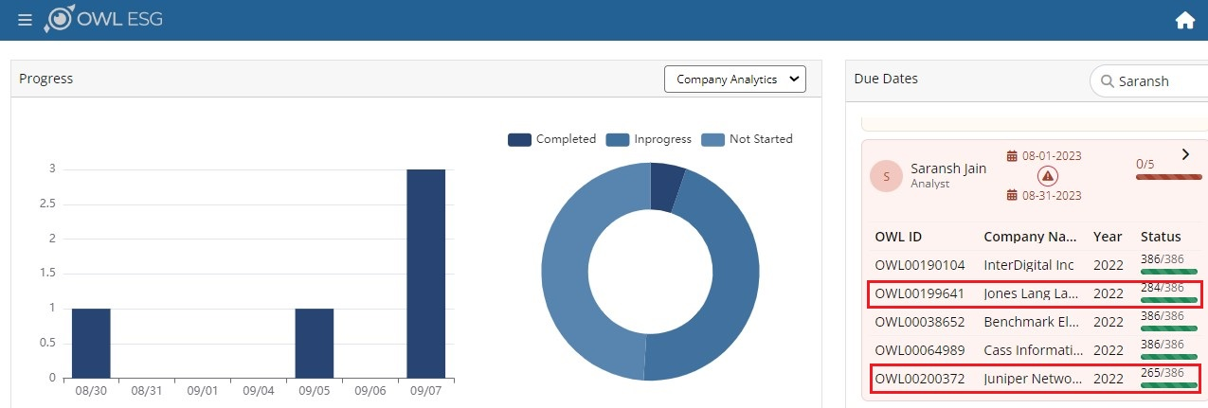
DRA Administration
Adding an Analyst
Assigning Company to an Analyst
  Existing
  New
Tracking Analyst Progress
Assigning Companies to an Existing Analyst
Assigning Companies to a New Analyst
Notes:
Existing Analyst: This refers to analysts who already have companies assigned to them for work.
After the admin chooses the analyst, they simply need to click on the tick icon in front of the analyst's name. This will turn the icon green. Subsequently, clicking the "Assign" button triggers a new pop-up window to appear. In this pop-up window, the admin can input the start date and end date. These dates determine the timeframe within which the assigned companies need to be completed. For instance, if the admin assigns 4 companies to an analyst with the requirement that they all must be completed on the same date, the start and end dates will be same.
If an analyst fails to complete the assigned companies within the set timeframe, the system will automatically mark them as overdue and display the number of days that have passed since the target date.
New Analyst: This pertains to assigning the selected companies to an analyst who hasn't been assigned any companies yet.
Once the admin decides to assign the companies to a new analyst, they should click on the "New" circular icon. This action will open up a list of all the analyst names available for assignment. The subsequent steps in the process remain the same as previously mentioned.

Slide 4
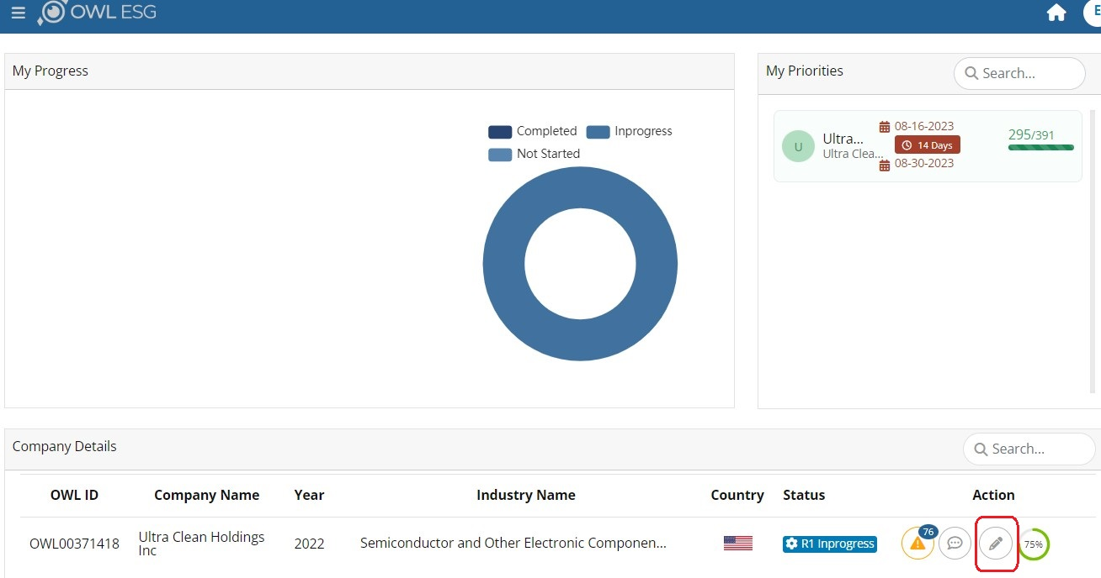
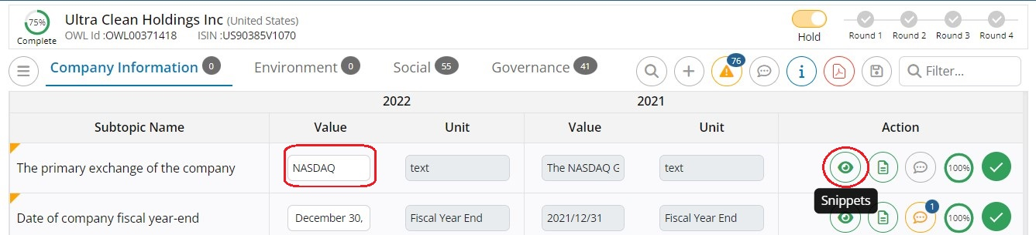
DRA Data Access / Documentation
Opening up a company's data page
Selecting a data point's snippet
Selecting a data point's document
Adding a snippet
Thumbs up a snippet
Notes:
When the snippet icon is tapped, the screen splits into two parts. On the left side, the subtopic is displayed along with its corresponding value and unit. On the right side, the snippet is presented, showing the specific section from which the analyst marked the data point. Additionally, the snippet includes information about the report that was referred to when marking the data point, along with the corresponding page number.

Slide 5
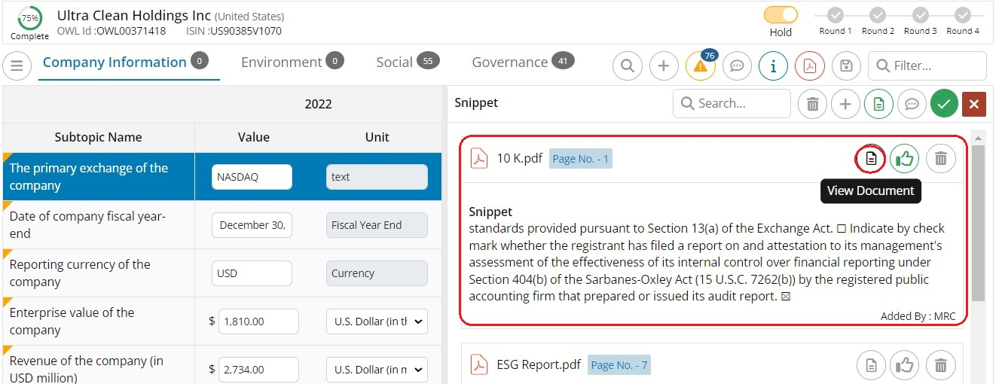
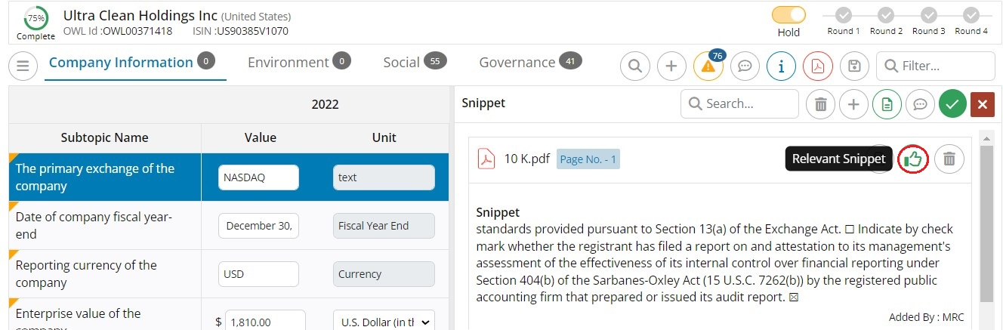
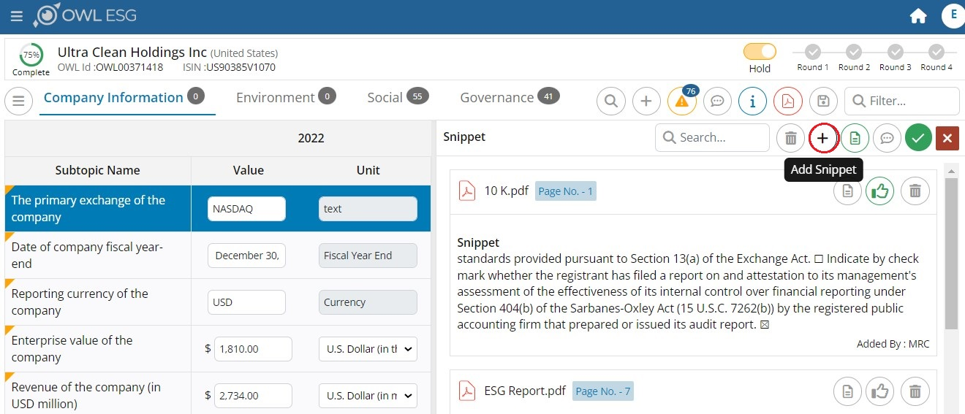
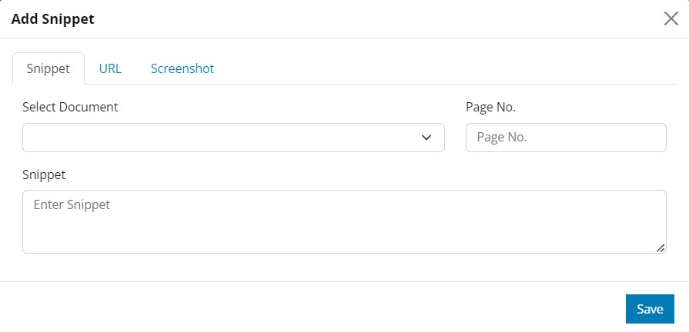
DRA Data Access / Documentation
Opening up a company's data page
Selecting a data point's snippet
Selecting a data point's document
Thumbs up a snippet
Adding a snippet
Notes:
The thumb icon located in the right corner of the snippet side enables you to select the appropriate snippet when multiple snippets are available. This situation typically occurs when the MRC engine runs on the company document to extract data from the report, resulting in the generation of multiple snippets. As an analyst, you will review the snippets and identify the most relevant one. By clicking on the thumb icon, you can tag and choose the preferred snippet that best corresponds to the subtopic and provides accurate information for the assessment. Once you tag a snippet by clicking the thumb icon, it will be prominently displayed at the top line of the snippet screen. This ensures easy visibility and quick reference to the selected snippet, allowing for efficient navigation and verification of the chosen data source.

Slide 6
DRA Data Access / Documentation
Opening up a company's data page
Selecting a data point's snippet
Selecting a data point's document
Thumbs up a snippet
Adding a snippet
Notes:
The thumb icon located in the right corner of the snippet side enables you to select the appropriate snippet when multiple snippets are available. This situation typically occurs when the MRC engine runs on the company document to extract data from the report, resulting in the generation of multiple snippets. As an analyst, you will review the snippets and identify the most relevant one. By clicking on the thumb icon, you can tag and choose the preferred snippet that best corresponds to the subtopic and provides accurate information for the assessment. Once you tag a snippet by clicking the thumb icon, it will be prominently displayed at the top line of the snippet screen. This ensures easy visibility and quick reference to the selected snippet, allowing for efficient navigation and verification of the chosen data source.

Slide 7
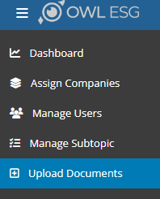
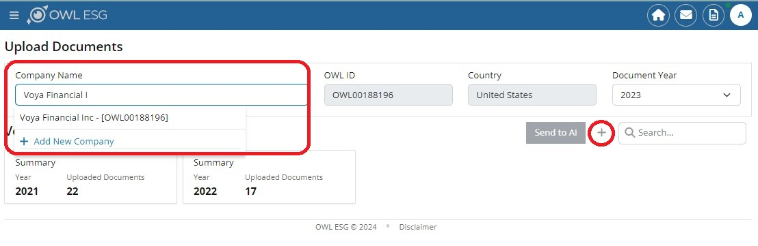
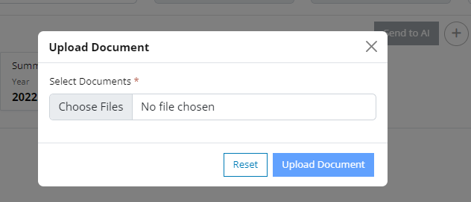
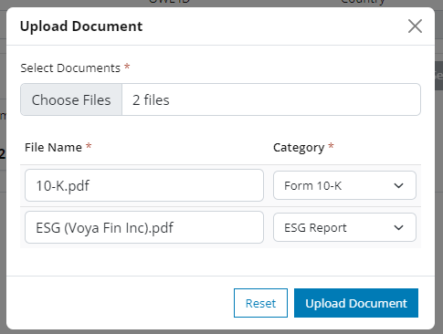
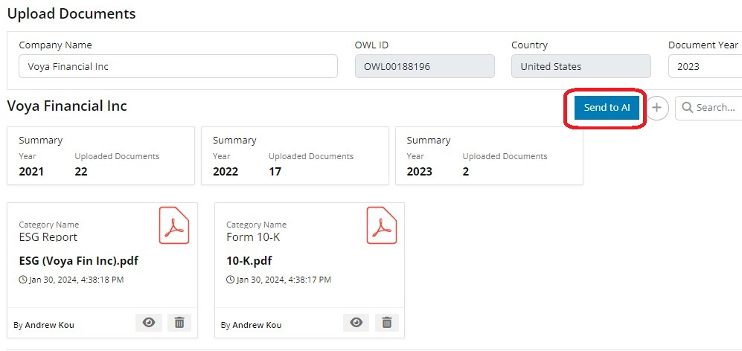
DRA Addition of Documents by User (Part A)
Add Documents via “Upload Documents”
Select files to upload
Activate documents scanning process (MRC processing)
Adding documents to an existing company: Search for the Company, indicate the Document year,
and proceed with Adding Documents “+”
Additional Notes to User:
Ensure that PDF file’s extension ends with “.pdf” (lower case)
The PDF file name should not contain the “+” special character
Make sure the document is not a scanned PDF, the system will not be able to automate the document scanning successfully
Select a File or Files to upload. Flexibility to re-name file(s)
Activate the “Send to AI” button to automate document scanning. The button remains disabled until all scanning has completed

Slide 8
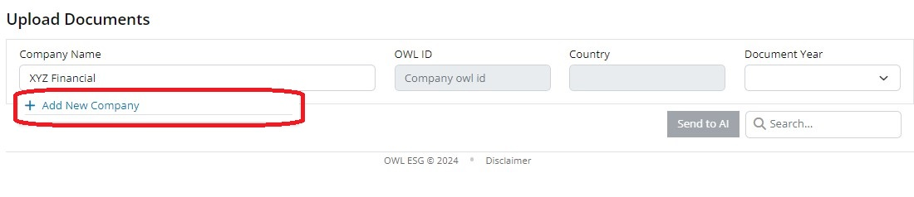
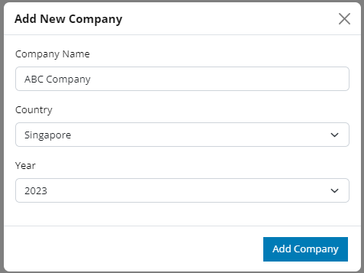
DRA Addition of Documents by User (Part B)
Add Documents via “Upload Documents”
If a Company does not exist in the DRA, “Add New Company“
Select files to upload (as stated in Part A)
Activate documents scanning process (MRC processing)
Create a New Company
Additional Notes to User:
Ensure that PDF file’s extension ends with “.pdf” (lower case)
The PDF file name should not contain the “+” special character
Make sure the document is not a scanned PDF, the system will not be able to automate the document scanning successfully
Adding documents to an existing company: Search for the Company, indicate the Document year,
and proceed with Adding Documents “+” (Refer to Part A slide)

Slide 9
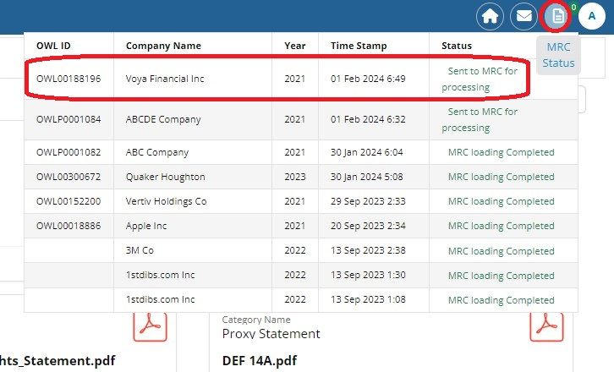
DRA Addition of Documents by User
Add Documents via “Upload Documents”
Select files to upload
Activate documents scanning process (MRC processing)
MRC Processing status will be reflected once the “Send to AI” button is activated
Additional Notes to User:
Ensure that PDF file’s extension ends with “.pdf” (lower case)
The PDF file name should not contain the “+” special character
Make sure the document is not a scanned PDF, the system will not be able to automate the document scanning successfully

Slide 10
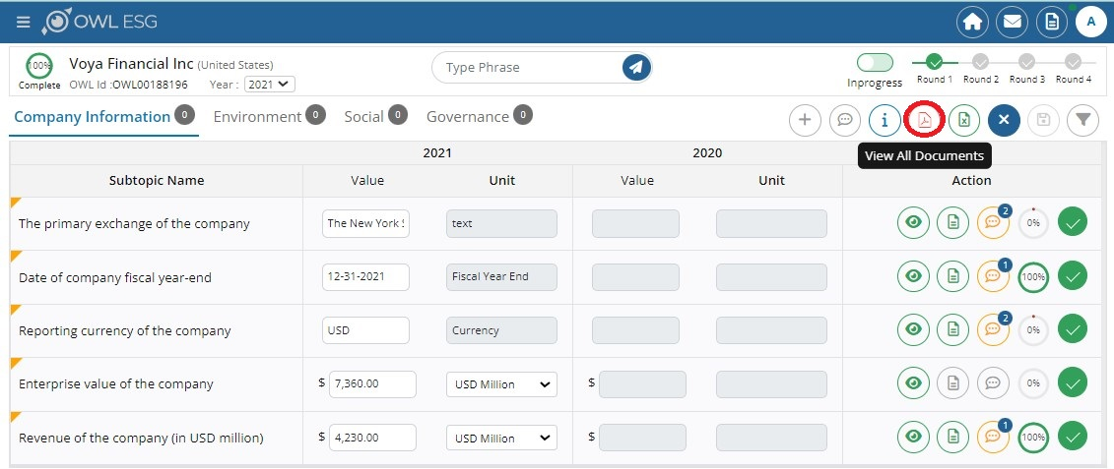
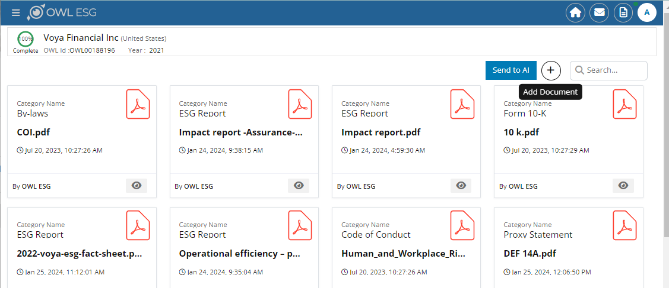
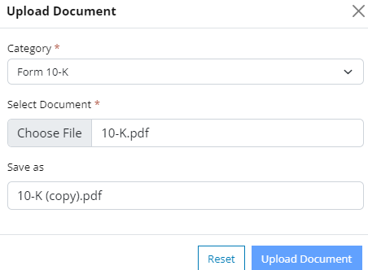
DRA Addition of Documentation or Sub-topic by User
Viewing the Document Library for a company
Adding an external document
Adding a new subtopic
Adding a snippet to the new subtopic
Adding a document to the new subtopic
Additional Notes to User:
Ensure that PDF file’s extension ends with “.pdf” (lower case)
The PDF file name should not contain the “+” special character
Make sure the document is not a scanned PDF, the system will not be able to automate the document scanning successfully
MRC Processing status will be reflected once the “Send to AI” button is activated

Slide 11
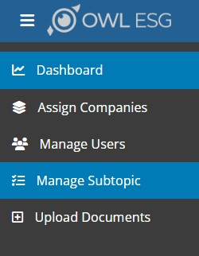
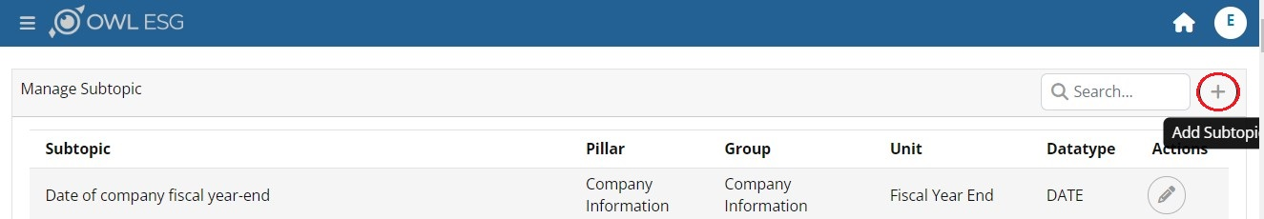
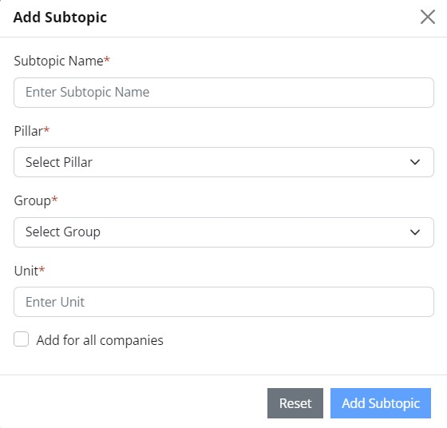
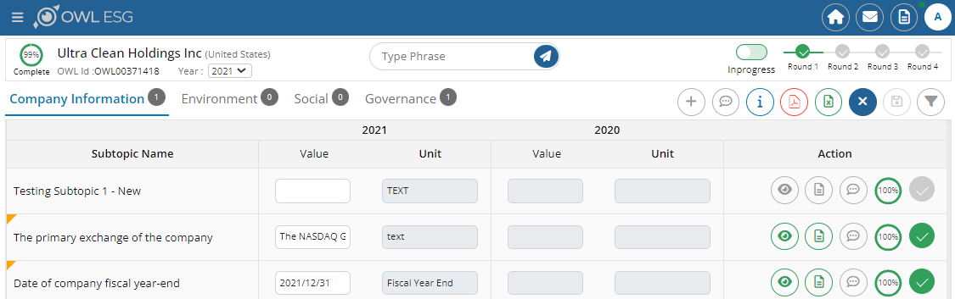
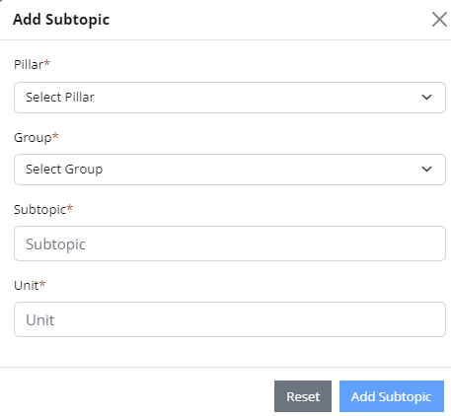
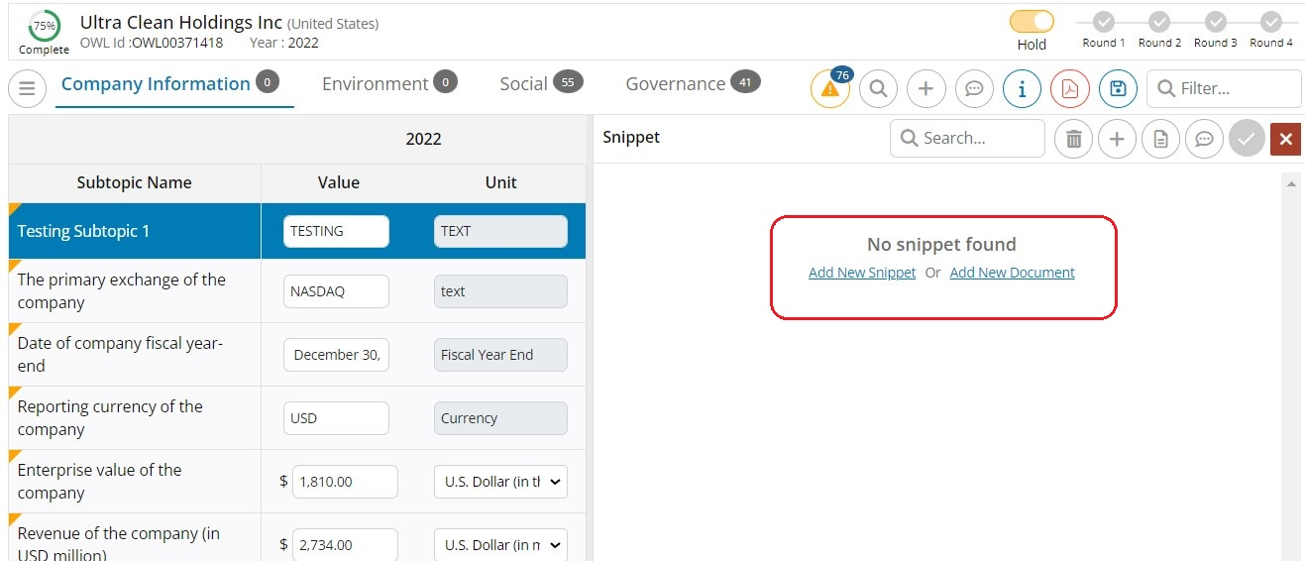
DRA Addition of Documentation or Sub-topic by User
Viewing the Document Library for a company
Adding an external document
Adding a new subtopic
Adding a snippet to the new subtopic
Adding a document to the new subtopic

Slide 12
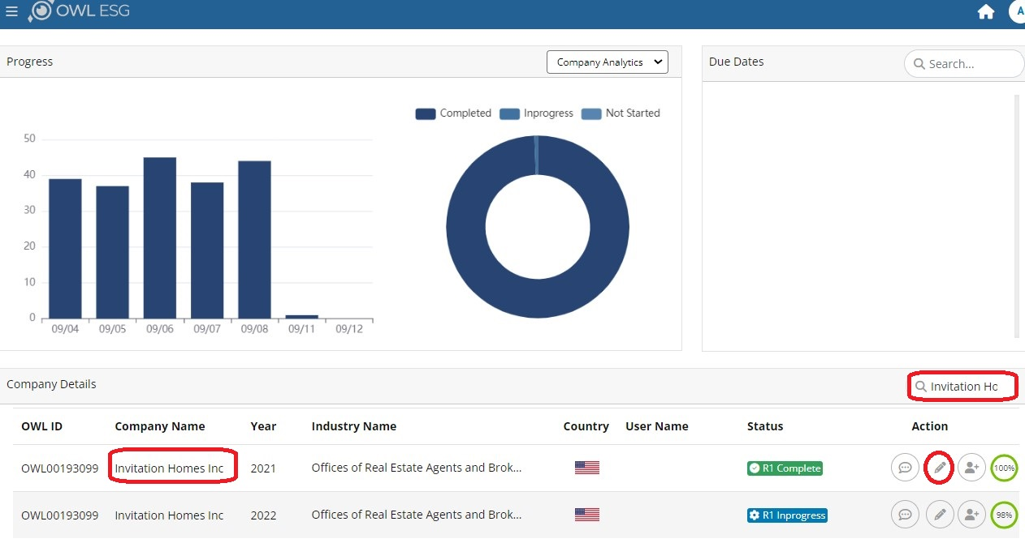
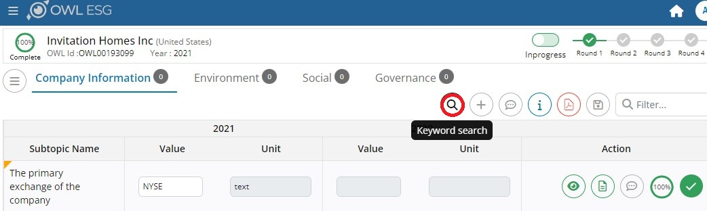
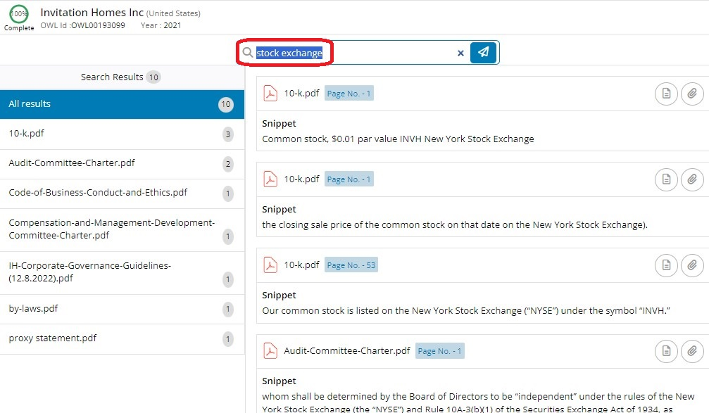
DRA Keyword Search
Searching documentation on a company
Adding a new found snippet to a subtopic
Adding a new subtopic and assigning the snippet to the new subtopic

Slide 13
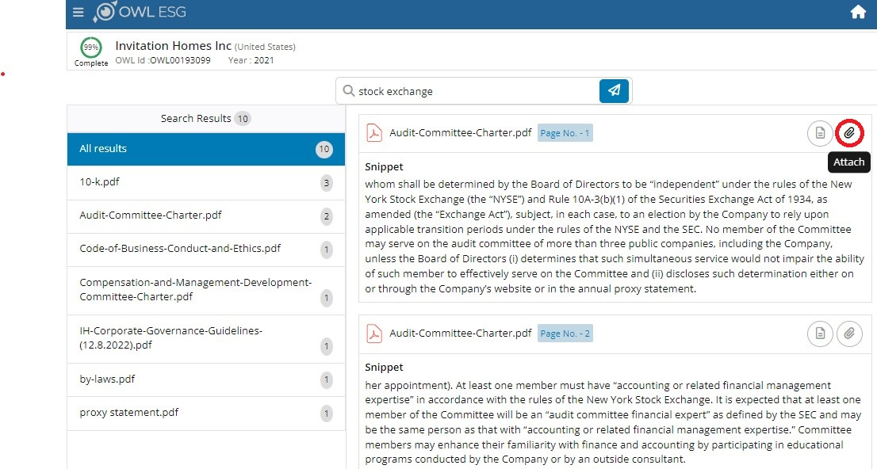
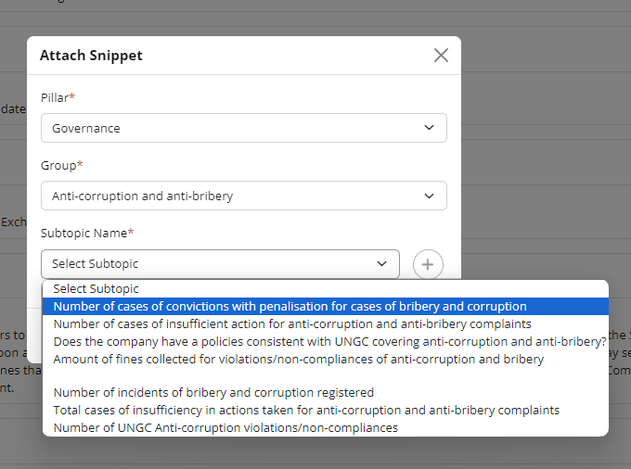
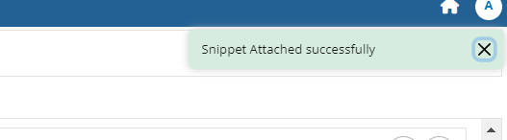
DRA Keyword Search
Searching documentation on a company
Adding a new found snippet to a subtopic
Adding a new subtopic and assigning the snippet to the new subtopic

Slide 14
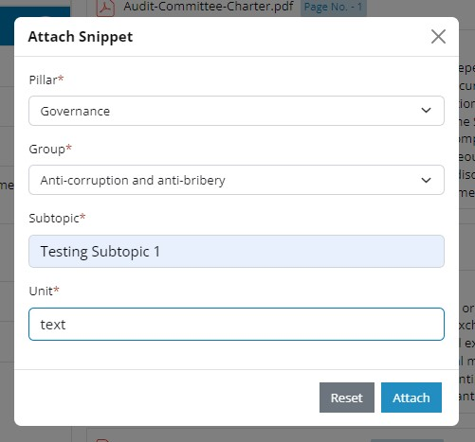
DRA Keyword Search
Searching documentation on a company
Adding a new found snippet to a subtopic
Adding a new subtopic and assigning the snippet to the new subtopic

